Slide 1

Lecture Series: Thermodynamics of polymer blends and solutions
Pierre J. Walker

Slide 2
Overview
Flory–Huggins Equation
Derivation
Stability and Equilibrium
Criticality
Application
Polymer solutions
Dilute mixtures
Semi-dilute solutions
Beyond Flory–Huggins
Alternative theories
Polyelectrolytes
PEO+IL system

Slide 3
Flory–Huggins Equation

Slide 4
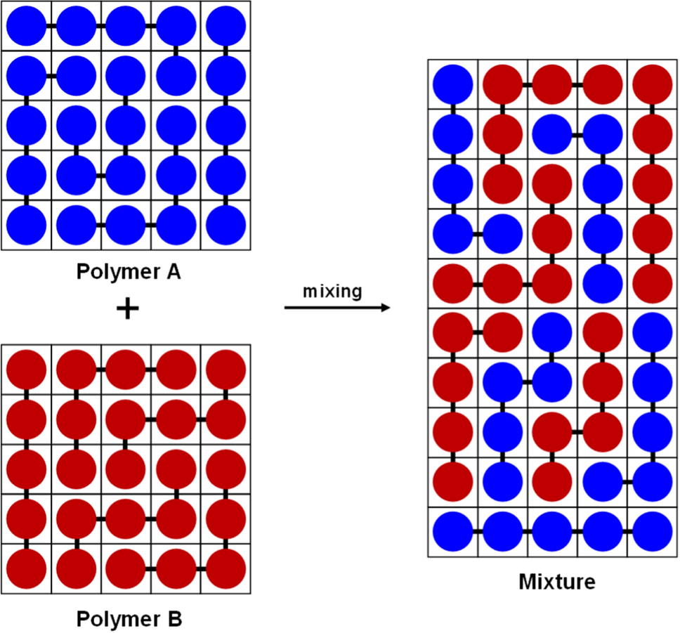
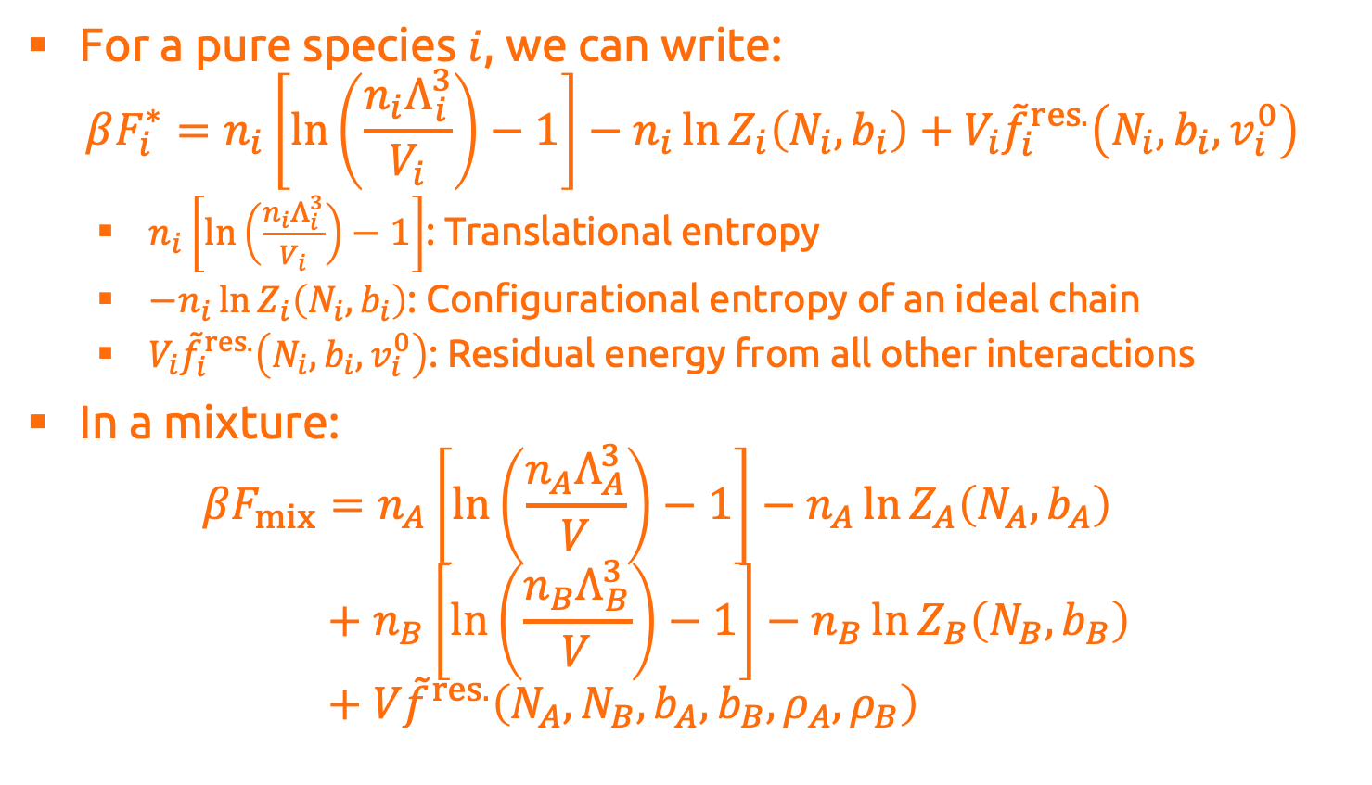
Derivation of Flory–Huggins
For a pure species $i$, we can write: $βF_{i}^{∗}=n_{i}\left[\ln\left(\frac{n_{i}Λ_{i}^{3}}{V_{i}}\right)−1\right]−n_{i}\ln{Z_{i}\left(N_{i},b_{i}\right)}+V_{i}{\tilde{f}}_{i}^{res.}\left(N_{i},b_{i},v_{i}^{0}\right)$
$n_{i}\left[\ln\left(\frac{n_{i}Λ_{i}^{3}}{V_{i}}\right)−1\right]$: Translational entropy
$−n_{i}\ln{Z_{i}\left(N_{i},b_{i}\right)}$: Configurational entropy of an ideal chain
$V_{i}{\tilde{f}}_{i}^{res.}\left(N_{i},b_{i},v_{i}^{0}\right)$: Residual energy from all other interactions
In a mixture: $βF_{mix}=n_{A}\left[\ln\left(\frac{n_{A}Λ_{A}^{3}}{V}\right)−1\right]−n_{A}\ln{Z_{A}\left(N_{A},b_{A}\right)}$ $βF_{mix}+n_{B}\left[\ln\left(\frac{n_{B}Λ_{B}^{3}}{V}\right)−1\right]−n_{B}\ln{Z_{B}\left(N_{B},b_{B}\right)}$ $βF_{mix}+V{\tilde{f}}^{res.}\left(N_{A},N_{B},b_{A},b_{B},ρ_{A},ρ_{B}\right)$

Slide 5
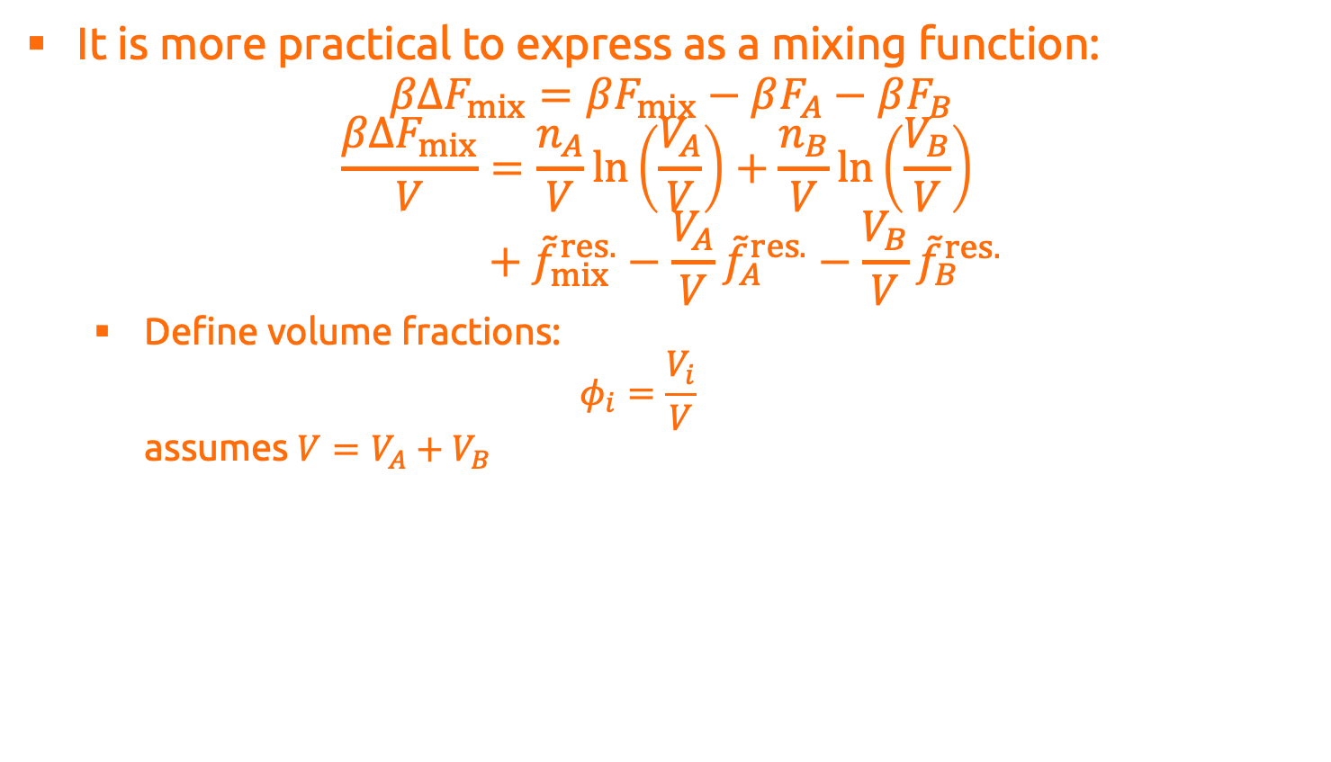
Derivation of Flory–Huggins
It is more practical to express as a mixing function: $βΔF_{mix}=βF_{mix}−βF_{A}−βF_{B}$
$$\frac{βΔF_{mix}}{V}=\frac{n_{A}}{V}\ln\left(\frac{V_{A}}{V}\right)+\frac{n_{B}}{V}\ln\left(\frac{V_{B}}{V}\right) \\ \frac{βΔF_{mix}}{V}+{\tilde{f}}_{mix}^{res.}−\frac{V_{A}}{V}{\tilde{f}}_{A}^{res.}−\frac{V_{B}}{V}{\tilde{f}}_{B}^{res.}$$
Define volume fractions: $φ_{i}=\frac{V_{i}}{V}$ assumes $V=V_{A}+V_{B}$

Slide 6
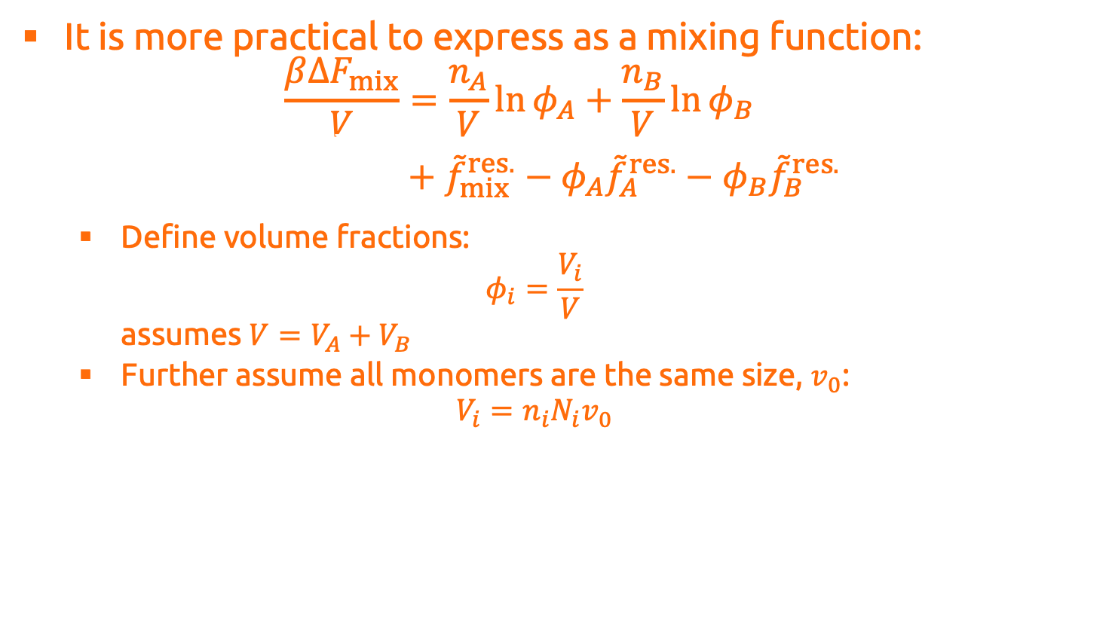
Derivation of Flory–Huggins
It is more practical to express as a mixing function:
$$\frac{βΔF_{mix}}{V}=\frac{n_{A}}{V}\ln{φ_{A}}+\frac{n_{B}}{V}\ln{φ_{B}} \\ \frac{βΔF_{mix}}{V}+{\tilde{f}}_{mix}^{res.}−φ_{A}{\tilde{f}}_{A}^{res.}−φ_{B}{\tilde{f}}_{B}^{res.}$$
Define volume fractions: $φ_{i}=\frac{V_{i}}{V}$ assumes $V=V_{A}+V_{B}$
Further assume all monomers are the same size, $v_{0}$: $V_{i}=n_{i}N_{i}v_{0}$

Slide 7
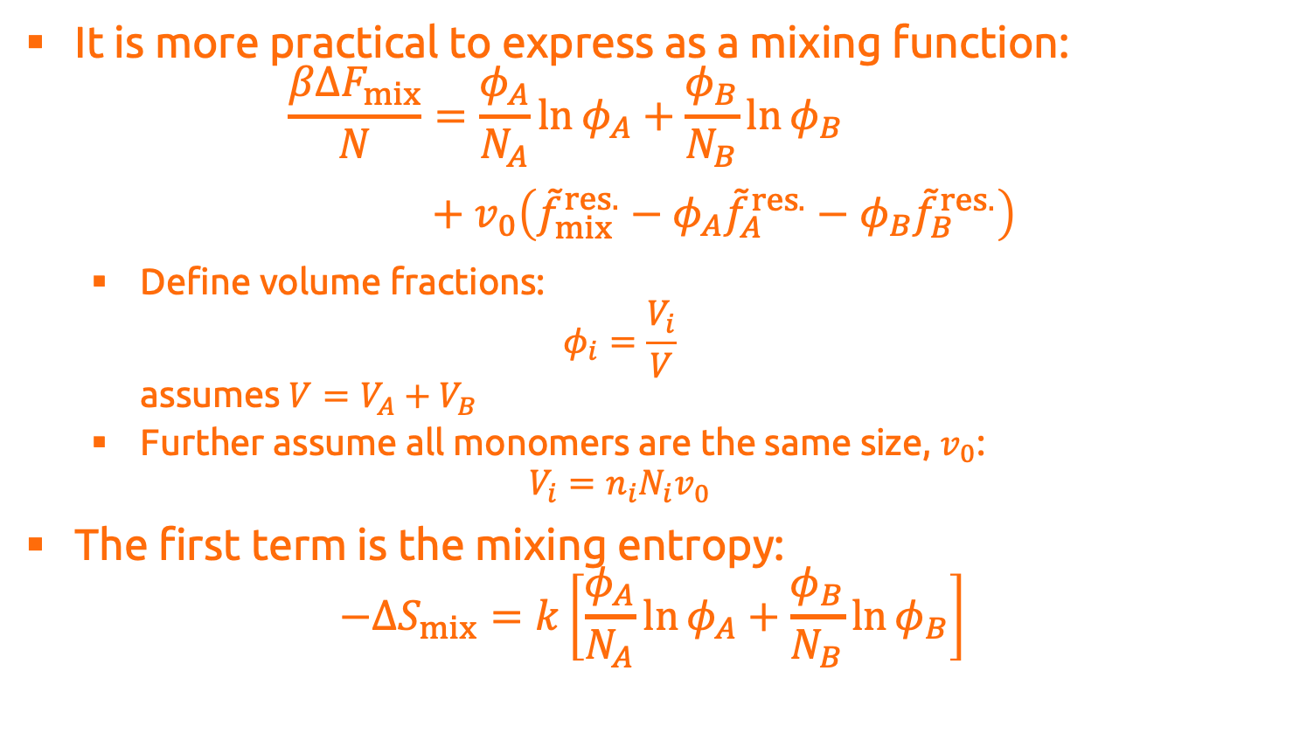
Derivation of Flory–Huggins
It is more practical to express as a mixing function:
$$\frac{βΔF_{mix}}{N}=\frac{φ_{A}}{N_{A}}\ln{φ_{A}}+\frac{φ_{B}}{N_{B}}\ln{φ_{B}} \\ \frac{βΔF_{mix}}{V}+v_{0}\left({\tilde{f}}_{mix}^{res.}−φ_{A}{\tilde{f}}_{A}^{res.}−φ_{B}{\tilde{f}}_{B}^{res.}\right)$$
Define volume fractions: $φ_{i}=\frac{V_{i}}{V}$ assumes $V=V_{A}+V_{B}$
Further assume all monomers are the same size, $v_{0}$: $V_{i}=n_{i}N_{i}v_{0}$
The first term is the mixing entropy: $−ΔS_{mix}=k\left[\frac{φ_{A}}{N_{A}}\ln{φ_{A}}+\frac{φ_{B}}{N_{B}}\ln{φ_{B}}\right]$

Slide 8
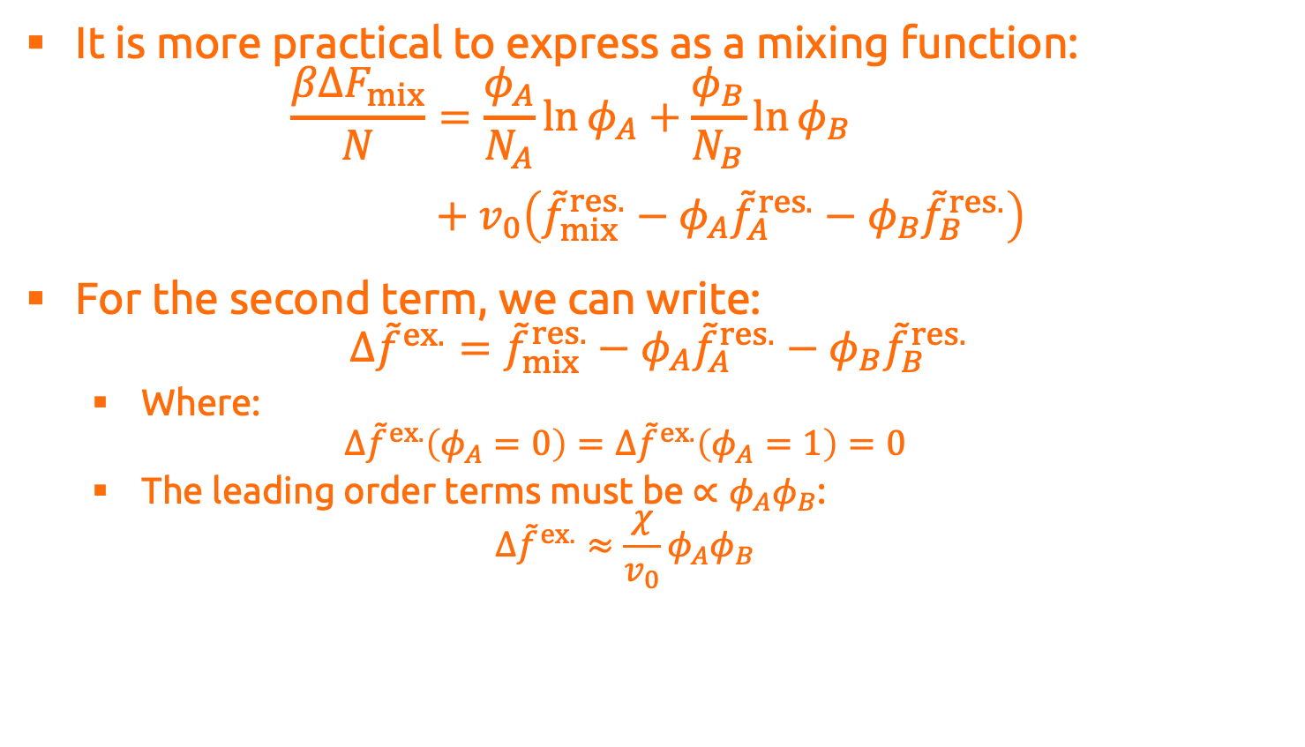
Derivation of Flory–Huggins
It is more practical to express as a mixing function:
$$\frac{βΔF_{mix}}{N}=\frac{φ_{A}}{N_{A}}\ln{φ_{A}}+\frac{φ_{B}}{N_{B}}\ln{φ_{B}} \\ \frac{βΔF_{mix}}{V}+v_{0}\left({\tilde{f}}_{mix}^{res.}−φ_{A}{\tilde{f}}_{A}^{res.}−φ_{B}{\tilde{f}}_{B}^{res.}\right)$$
For the second term, we can write: $Δ{\tilde{f}}^{ex.}={\tilde{f}}_{mix}^{res.}−φ_{A}{\tilde{f}}_{A}^{res.}−φ_{B}{\tilde{f}}_{B}^{res.}$
Where: $Δ{\tilde{f}}^{ex.}\left(φ_{A}=0\right)=Δ{\tilde{f}}^{ex.}\left(φ_{A}=1\right)=0$
The leading order terms must be $∝φ_{A}φ_{B}$: $Δ{\tilde{f}}^{ex.}≈\frac{χ}{v_{0}}φ_{A}φ_{B}$

Slide 9
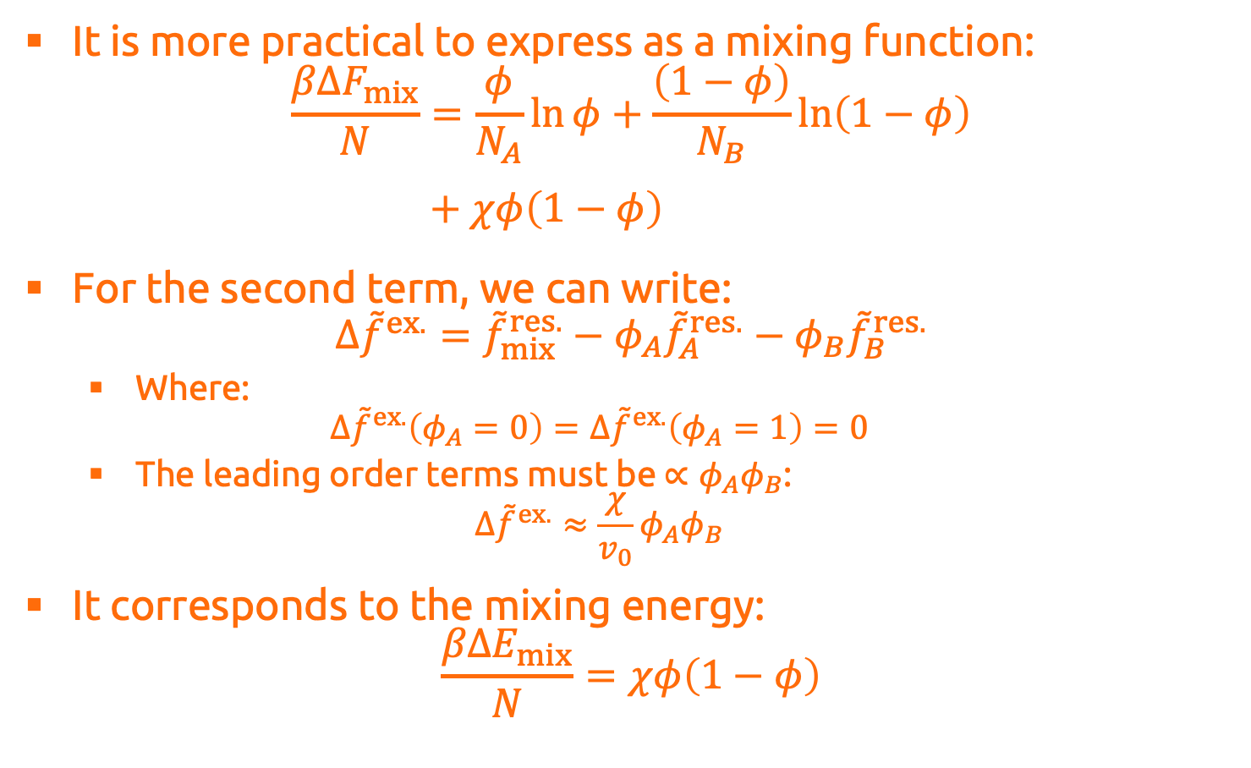
Derivation of Flory–Huggins
It is more practical to express as a mixing function:
$$\frac{βΔF_{mix}}{N}=\frac{φ}{N_{A}}\ln{φ}+\frac{\left(1−φ\right)}{N_{B}}\ln\left(1−φ\right) \\ \frac{βΔF_{mix}}{V}+χφ\left(1−φ\right)$$
For the second term, we can write: $Δ{\tilde{f}}^{ex.}={\tilde{f}}_{mix}^{res.}−φ_{A}{\tilde{f}}_{A}^{res.}−φ_{B}{\tilde{f}}_{B}^{res.}$
Where: $Δ{\tilde{f}}^{ex.}\left(φ_{A}=0\right)=Δ{\tilde{f}}^{ex.}\left(φ_{A}=1\right)=0$
The leading order terms must be $∝φ_{A}φ_{B}$: $Δ{\tilde{f}}^{ex.}≈\frac{χ}{v_{0}}φ_{A}φ_{B}$
It corresponds to the mixing energy: $\frac{βΔE_{mix}}{N}=χφ\left(1−φ\right)$

Slide 10
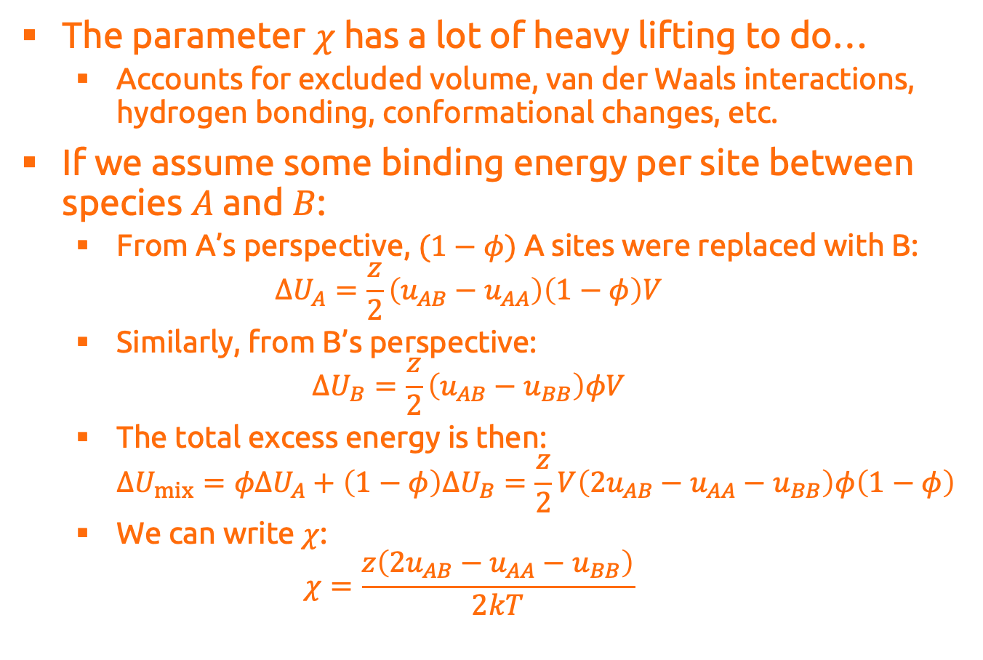
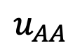
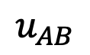
Derivation of Flory–Huggins
The parameter $χ$ has a lot of heavy lifting to do…
Accounts for excluded volume, van der Waals interactions, hydrogen bonding, conformational changes, etc.
If we assume some binding energy per site between species $A$ and $B$:
From A’s perspective, $(1−φ)$ A sites were replaced with B: $ΔU_{A}=\frac{z}{2}\left(u_{AB}−u_{AA}\right)\left(1−φ\right)V$
Similarly, from B’s perspective: $ΔU_{B}=\frac{z}{2}\left(u_{AB}−u_{BB}\right)φV$
The total excess energy is then: $ΔU_{mix}=φΔU_{A}+\left(1−φ\right)ΔU_{B}=\frac{z}{2}V\left(2u_{AB}−u_{AA}−u_{BB}\right)φ\left(1−φ\right)$
We can write $χ$: $χ=\frac{z\left(2u_{AB}−u_{AA}−u_{BB}\right)}{2kT}$
A
$$u_{AA}$$
$$u_{AB}$$
A
A
B
B

Slide 11
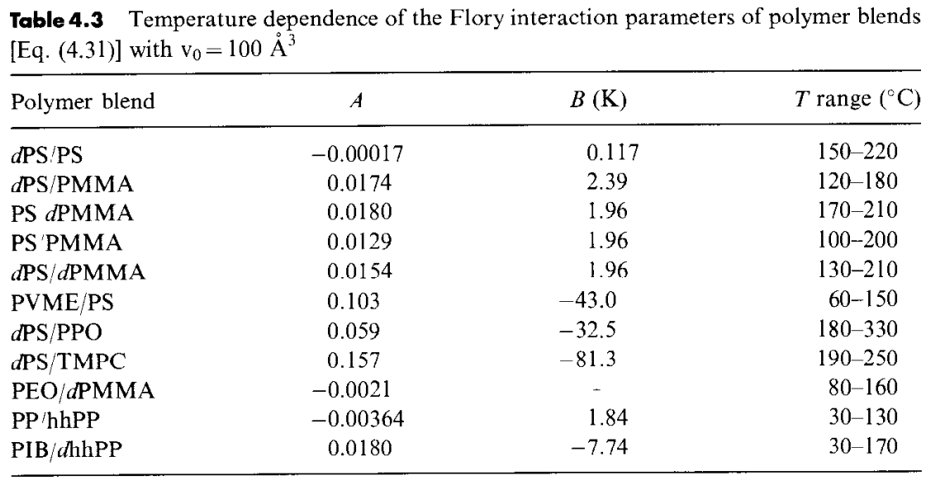
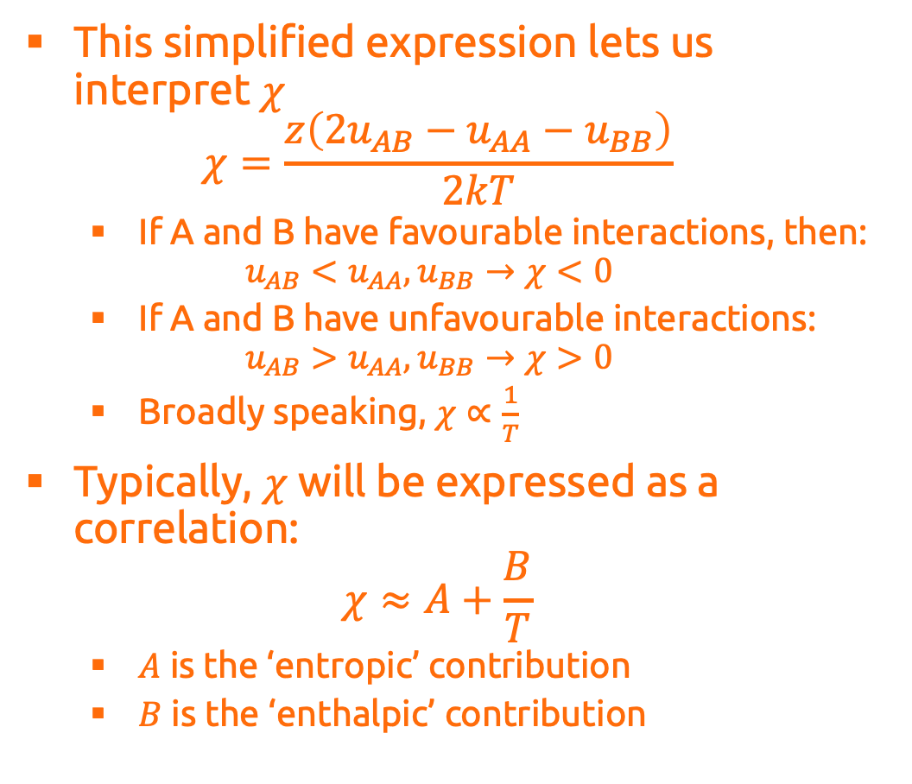
Derivation of Flory–Huggins
This simplified expression lets us interpret $χ$ $χ=\frac{z\left(2u_{AB}−u_{AA}−u_{BB}\right)}{2kT}$
If A and B have favourable interactions, then: $u_{AB}<u_{AA},u_{BB}→χ<0$
If A and B have unfavourable interactions: $u_{AB}>u_{AA},u_{BB}→χ>0$
Broadly speaking, $χ∝\frac{1}{T}$
Typically, $χ$ will be expressed as a correlation: $χ≈A+\frac{B}{T}$
$A$ is the ‘entropic’ contribution
$B$ is the ‘enthalpic’ contribution

Slide 12
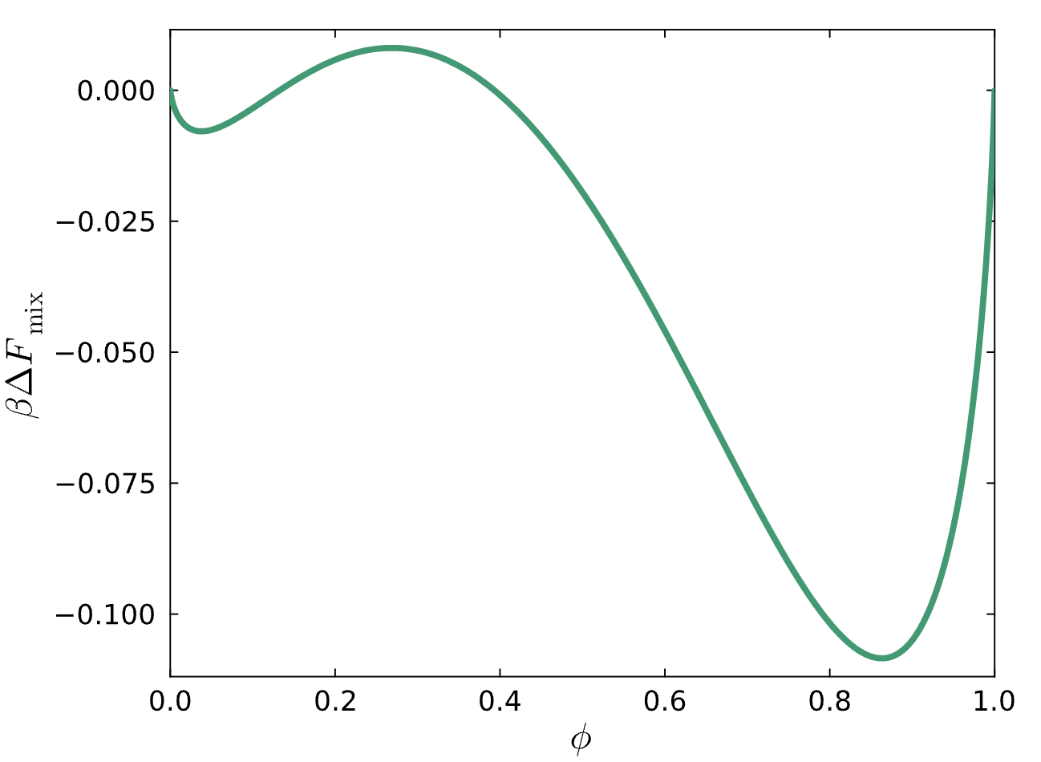
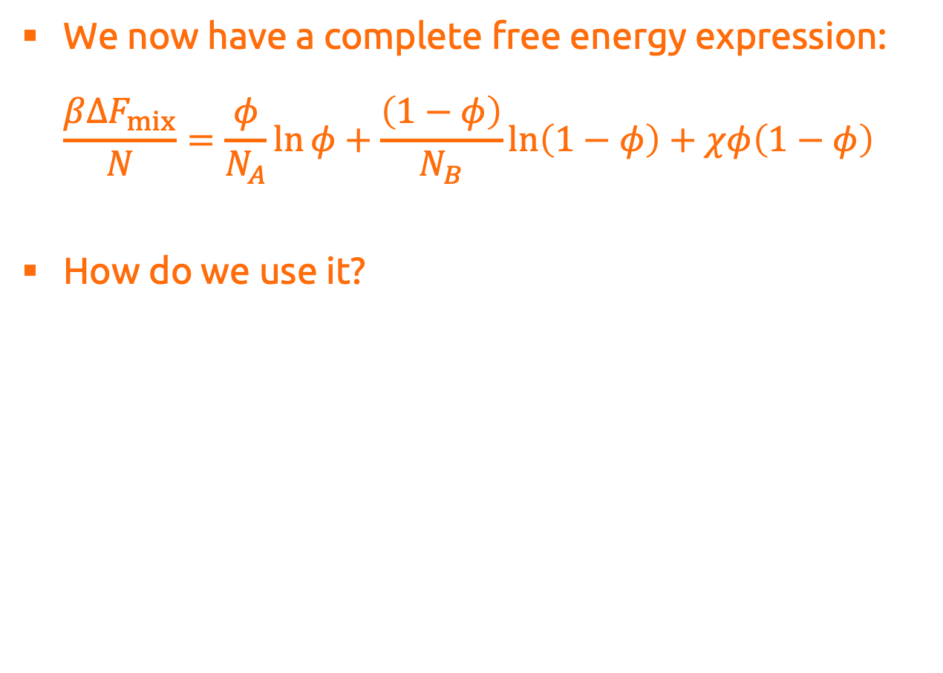
Derivation of Flory–Huggins
We now have a complete free energy expression: $\frac{βΔF_{mix}}{N}=\frac{φ}{N_{A}}\ln{φ}+\frac{\left(1−φ\right)}{N_{B}}\ln\left(1−φ\right)+χφ\left(1−φ\right)$
How do we use it?

Slide 13
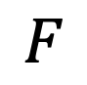

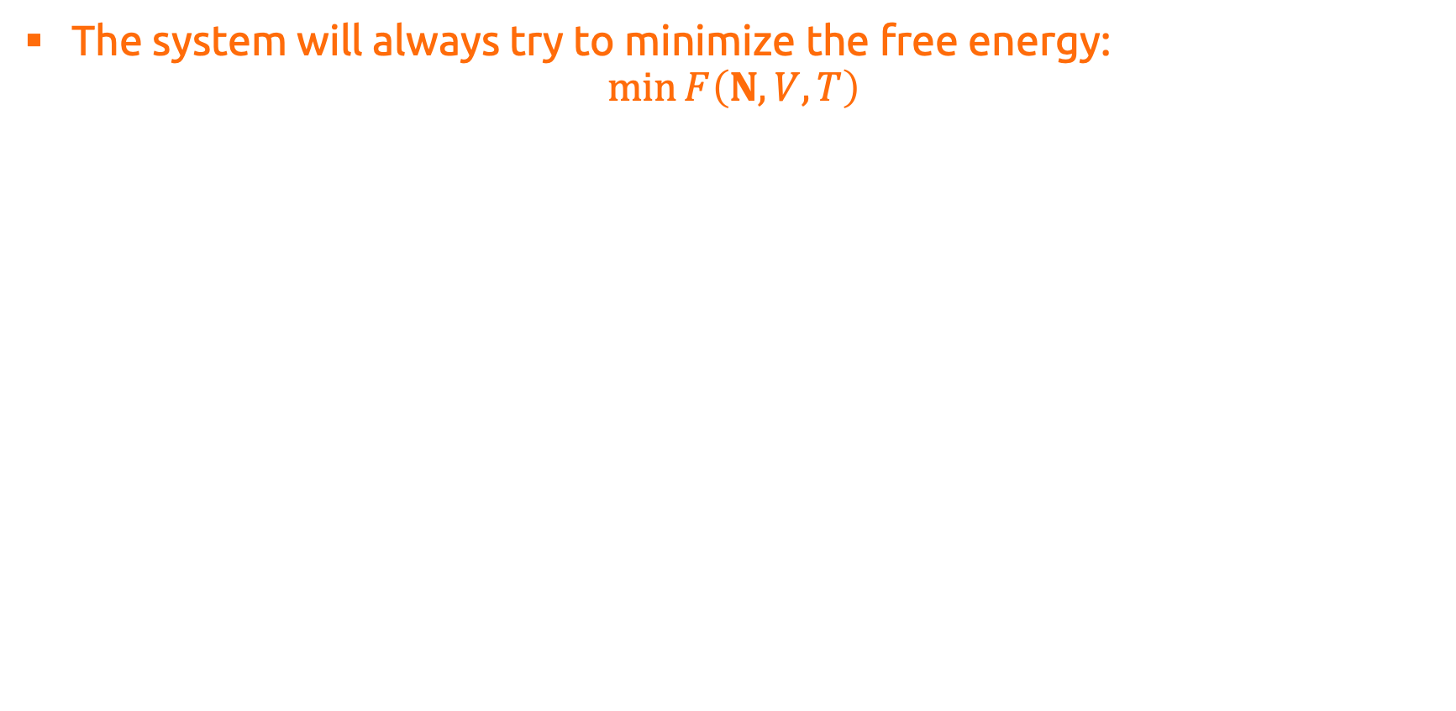



Stability and Equilibrium
The system will always try to minimize the free energy: $\min{F\left(N,V,T\right)}$
$$δ$$
$$F$$
$$δ$$
Unstable
$$δ$$
Metastable
$$δ$$
Stable
Local state variable

Slide 14
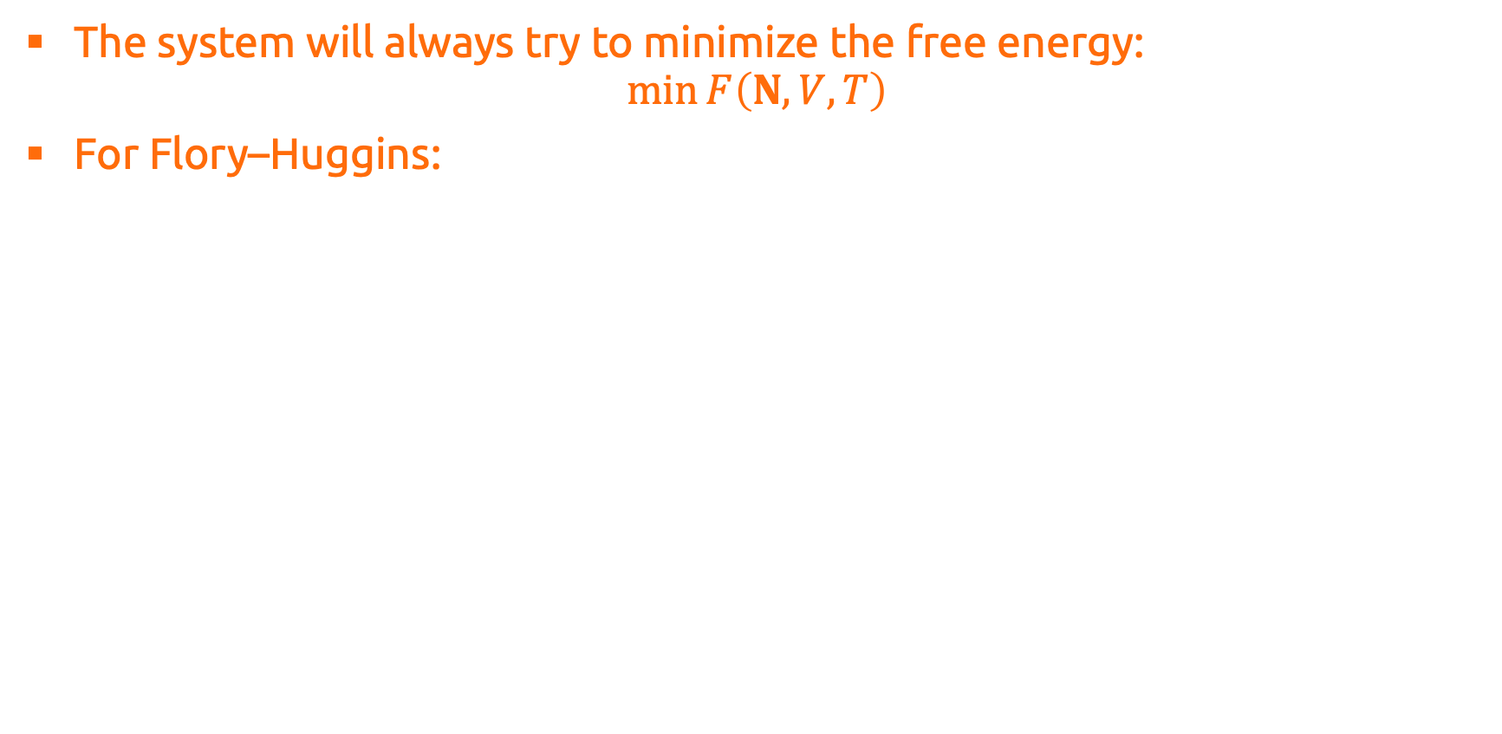
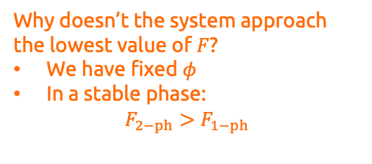
Stability and Equilibrium
The system will always try to minimize the free energy: $\min{F\left(N,V,T\right)}$
For Flory–Huggins:
Why doesn’t the system approach the lowest value of $F$?
We have fixed $φ$
In a stable phase: $F_{2−ph}>F_{1−ph}$

Slide 15
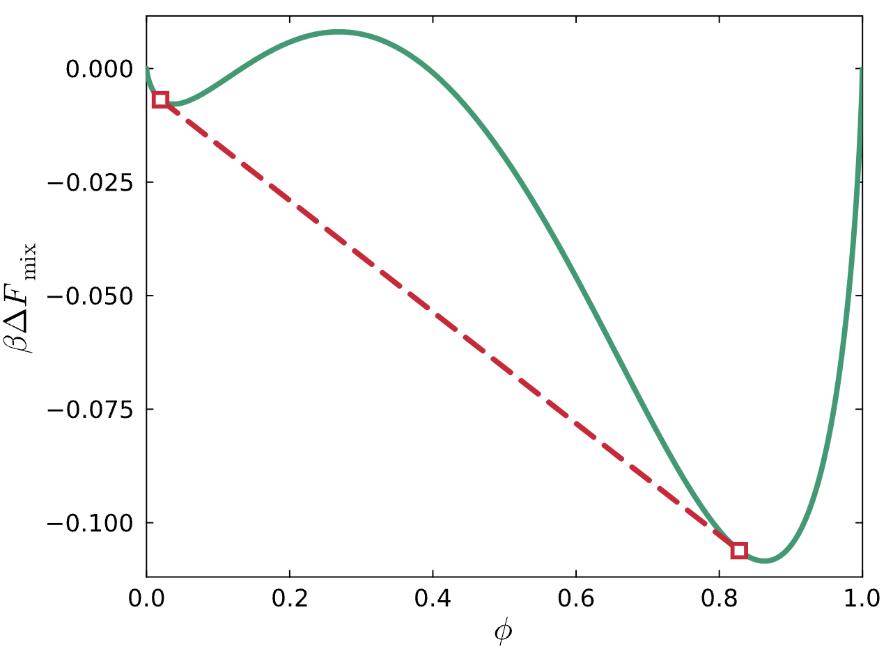

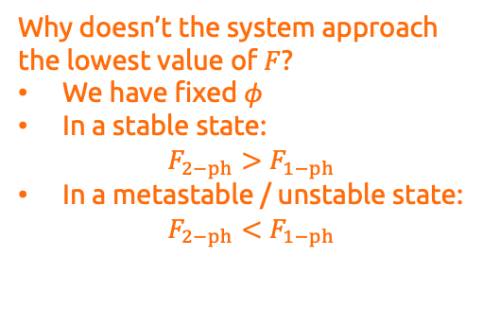
Stability and Equilibrium
The system will always try to minimize the free energy: $\min{F\left(N,V,T\right)}$
For Flory–Huggins:
Why doesn’t the system approach the lowest value of $F$?
We have fixed $φ$
In a stable state: $F_{2−ph}>F_{1−ph}$
In a metastable / unstable state: $F_{2−ph}<F_{1−ph}$

Slide 16
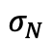
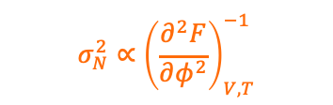
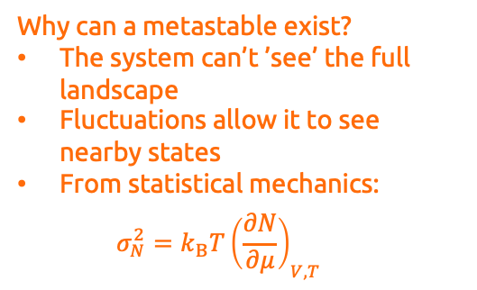
Stability and Equilibrium
The system will always try to minimize the free energy: $\min{F\left(N,V,T\right)}$
For Flory–Huggins:
Why can a metastable exist?
The system can’t ’see’ the full landscape
Fluctuations allow it to see nearby states
From statistical mechanics: a $σ_{N}^{2}=k_{B}T{\left(\frac{∂N}{∂μ}\right)}_{V,T}$
$$σ_{N}^{2}∝{\left(\frac{∂^{2}F}{∂φ^{2}}\right)}_{V,T}^{−1}$$
$$σ_{N}$$

Slide 17
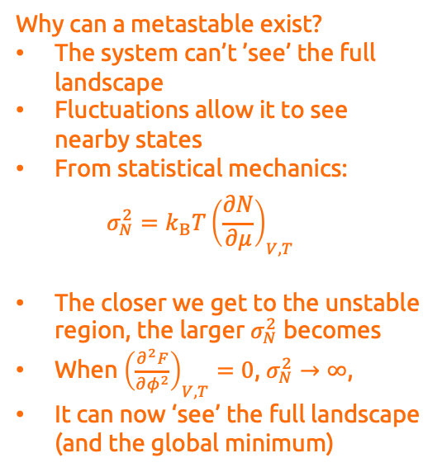
Stability and Equilibrium
The system will always try to minimize the free energy: $\min{F\left(N,V,T\right)}$
For Flory–Huggins:
Why can a metastable exist?
The system can’t ’see’ the full landscape
Fluctuations allow it to see nearby states
From statistical mechanics: a $σ_{N}^{2}=k_{B}T{\left(\frac{∂N}{∂μ}\right)}_{V,T}$
The closer we get to the unstable region, the larger $σ_{N}^{2}$ becomes
When ${\left(\frac{∂^{2}F}{∂φ^{2}}\right)}_{V,T}=0$, $σ_{N}^{2}→∞$,
It can now ‘see’ the full landscape (and the global minimum)
$$σ_{N}^{2}∝{\left(\frac{∂^{2}F}{∂φ^{2}}\right)}_{V,T}^{−1}$$

Slide 18
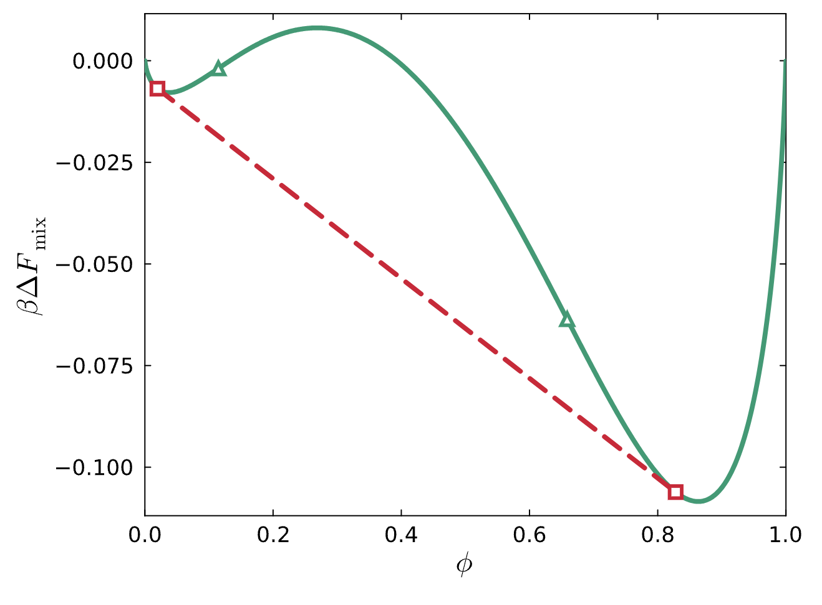
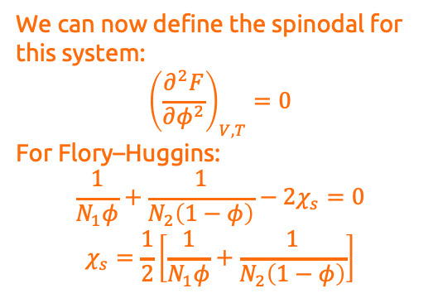
Stability and Equilibrium
The system will always try to minimize the free energy: $\min{F\left(N,V,T\right)}$
For Flory–Huggins:
Stable
Unstable
Stable
We can now define the spinodal for this system: $${\left(\frac{∂^{2}F}{∂φ^{2}}\right)}_{V,T}=0$$
For Flory–Huggins: $$\frac{1}{N_{1}φ}+\frac{1}{N_{2}\left(1−φ\right)}−2χ_{s}=0$$
$$χ_{s}=\frac{1}{2}\left[\frac{1}{N_{1}φ}+\frac{1}{N_{2}\left(1−φ\right)}\right]$$
Metastable
Metastable

Slide 19
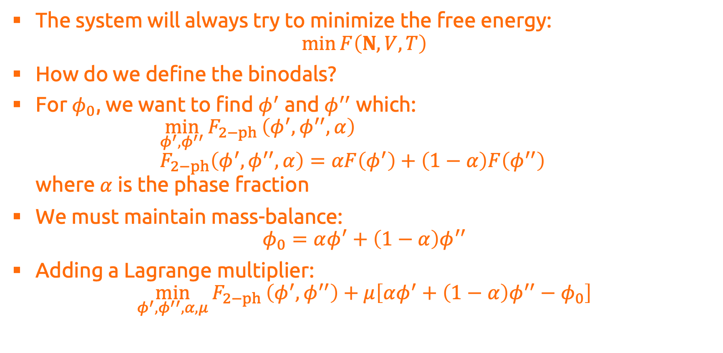
Stability and Equilibrium
The system will always try to minimize the free energy: $\min{F\left(N,V,T\right)}$
How do we define the binodals?
For $φ_{0}$, we want to find $φ^{′}$ and $φ^{′′}$ which: $\min_{φ^{′},φ^{′′}}{F_{2−ph}}\left(φ^{′},φ^{′′},α\right)$ $F_{2−ph}\left(φ^{′},φ^{′′},α\right)=αF\left(φ^{′}\right)+\left(1−α\right)F\left(φ^{′′}\right)$ where $α$ is the phase fraction
We must maintain mass-balance: $φ_{0}=αφ^{′}+\left(1−α\right)φ^{′′}$
Adding a Lagrange multiplier: $\min_{φ^{′},φ^{′′},α,μ}{F_{2−ph}}\left(φ^{′},φ^{′′}\right)+μ\left[αφ^{′}+\left(1−α\right)φ^{′′}−φ_{0}\right]$

Slide 20
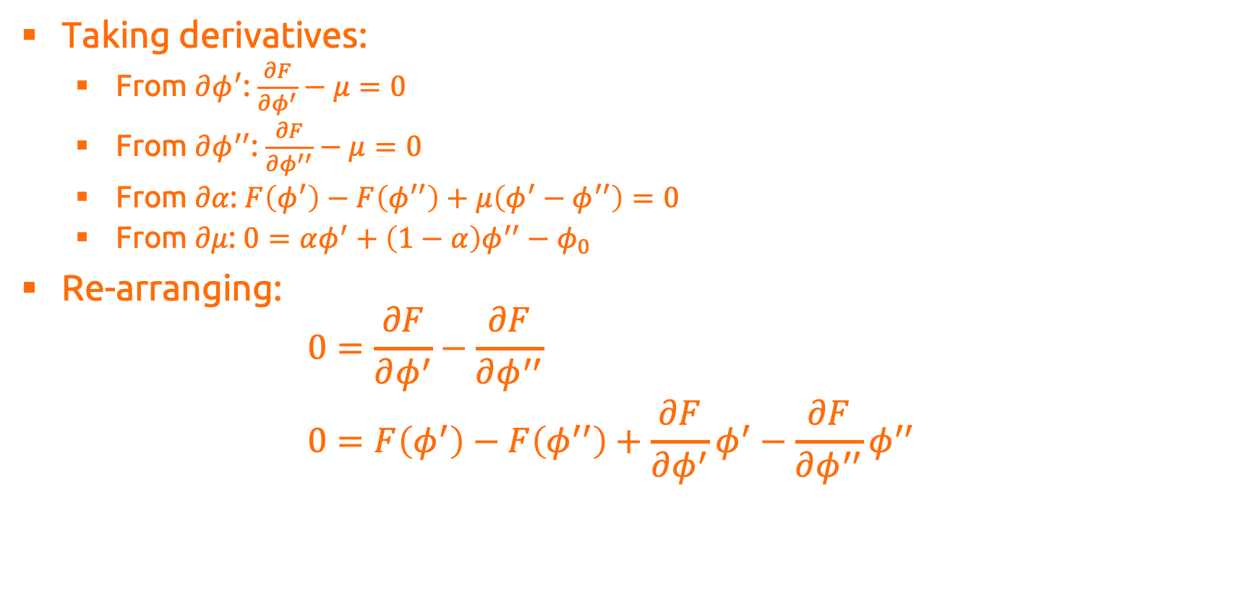


Stability and Equilibrium
Taking derivatives:
From $∂φ^{′}$: $\frac{∂F}{∂φ^{′}}−μ=0$
From $∂φ^{′′}$: $\frac{∂F}{∂φ^{′′}}−μ=0$
From $∂α$: $F\left(φ^{′}\right)−F\left(φ^{′′}\right)+μ\left(φ^{′}−φ^{′′}\right)=0$
From $∂μ$: $0=αφ^{′}+\left(1−α\right)φ^{′′}−φ_{0}$
Re-arranging: $0=\frac{∂F}{∂φ^{′}}−\frac{∂F}{∂φ^{′′}}$ $0=F\left(φ^{′}\right)−F\left(φ^{′′}\right)+\frac{∂F}{∂φ^{′}}φ^{′}−\frac{∂F}{∂φ^{′′}}φ^{′′}$
$$0=μ\left(φ^{′}\right)−μ\left(φ^{′′}\right)$$
Equality of chemical potential
$$0=Π\left(φ^{′}\right)−Π\left(φ^{′′}\right)$$
Equality of osmotic pressure

Slide 21
Stability and Equilibrium
Taking derivatives:
From $∂φ^{′}$: $\frac{∂F}{∂φ^{′}}−μ=0$
From $∂φ^{′′}$: $\frac{∂F}{∂φ^{′′}}−μ=0$
From $∂α$: $F\left(φ^{′}\right)−F\left(φ^{′′}\right)+μ\left(φ^{′}−φ^{′′}\right)=0$
From $∂μ$: $0=αφ^{′}+\left(1−α\right)φ^{′′}−φ_{0}$
Re-arranging: $0=\frac{∂F}{∂φ^{′}}−\frac{∂F}{∂φ^{′′}}$ $0=F\left(φ^{′}\right)−F\left(φ^{′′}\right)+\frac{∂F}{∂φ^{′}}φ^{′}−\frac{∂F}{∂φ^{′′}}φ^{′′}$
Equality of slopes
Equality of intercepts
Definition of a common tangent line!

Slide 22
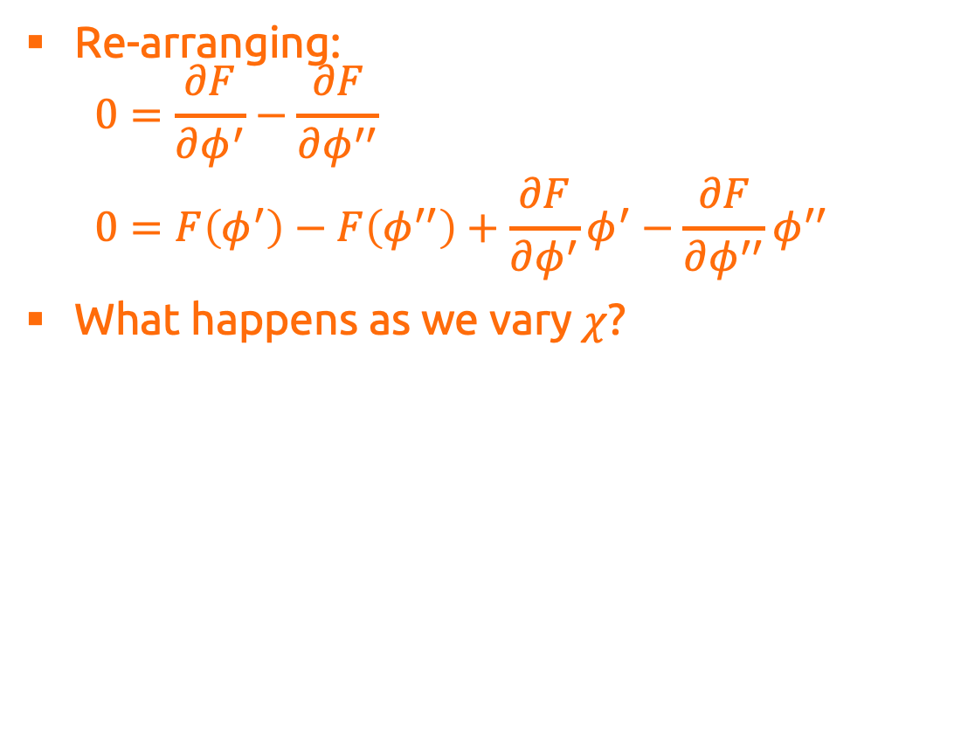
Stability and Equilibrium
Re-arranging: $0=\frac{∂F}{∂φ^{′}}−\frac{∂F}{∂φ^{′′}}$ $0=F\left(φ^{′}\right)−F\left(φ^{′′}\right)+\frac{∂F}{∂φ^{′}}φ^{′}−\frac{∂F}{∂φ^{′′}}φ^{′′}$
What happens as we vary $χ$?

Slide 23
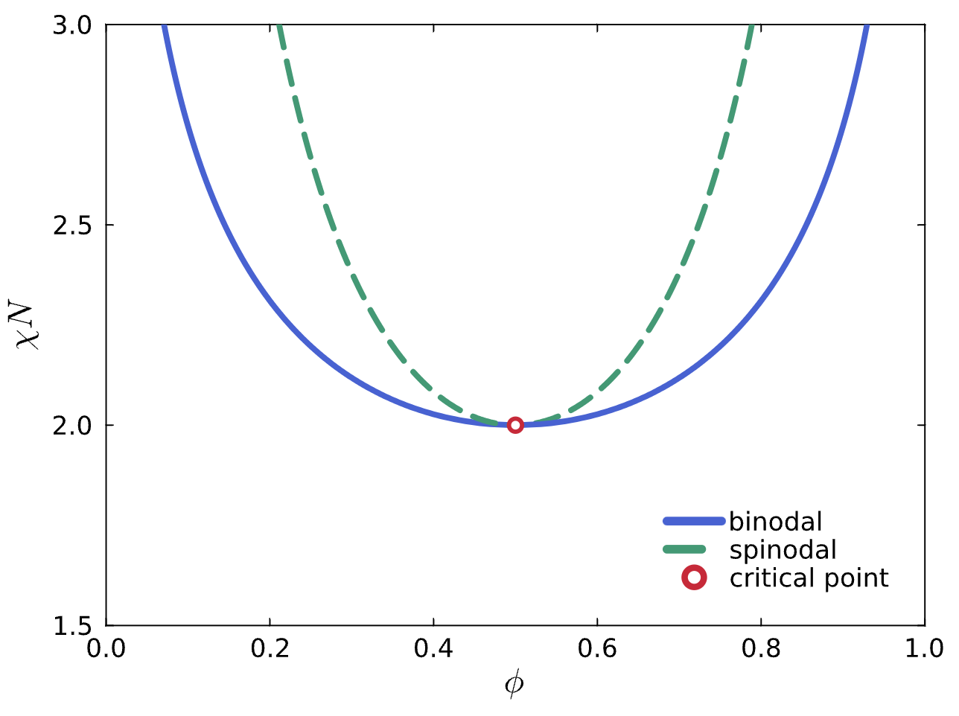
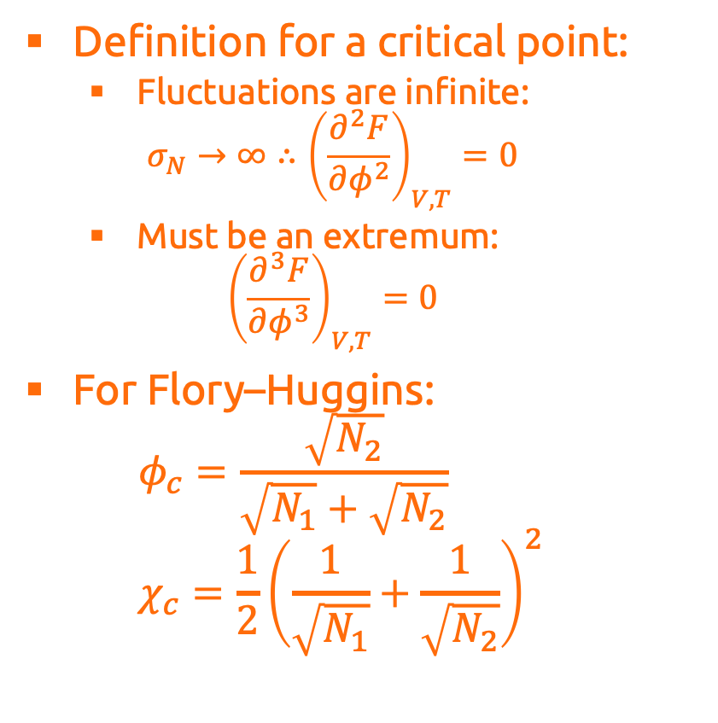
Criticality
Definition for a critical point:
Fluctuations are infinite: $σ_{N}→∞∴{\left(\frac{∂^{2}F}{∂φ^{2}}\right)}_{V,T}=0$
Must be an extremum: ${\left(\frac{∂^{3}F}{∂φ^{3}}\right)}_{V,T}=0$
For Flory–Huggins: $φ_{c}=\frac{\sqrt{N_{2}}}{\sqrt{N_{1}}+\sqrt{N_{2}}}$ $χ_{c}=\frac{1}{2}{\left(\frac{1}{\sqrt{N_{1}}}+\frac{1}{\sqrt{N_{2}}}\right)}^{2}$

Slide 24
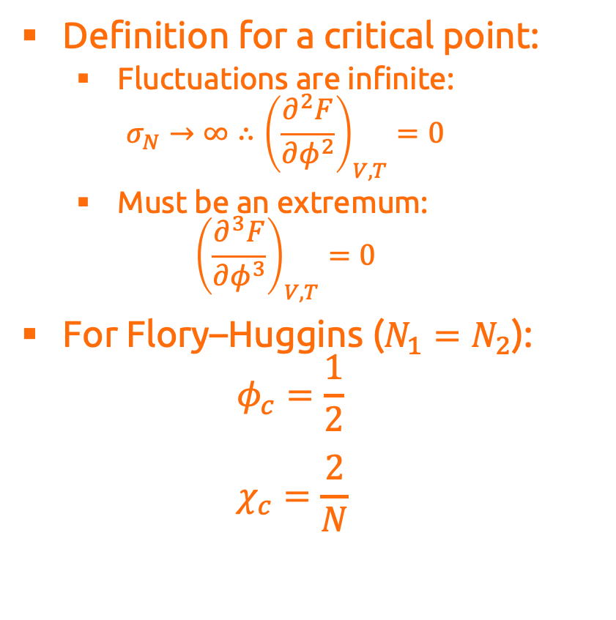
Criticality
Definition for a critical point:
Fluctuations are infinite: $σ_{N}→∞∴{\left(\frac{∂^{2}F}{∂φ^{2}}\right)}_{V,T}=0$
Must be an extremum: ${\left(\frac{∂^{3}F}{∂φ^{3}}\right)}_{V,T}=0$
For Flory–Huggins ($N_{1}=N_{2}$): $φ_{c}=\frac{1}{2}$ $χ_{c}=\frac{2}{N}$

Slide 25
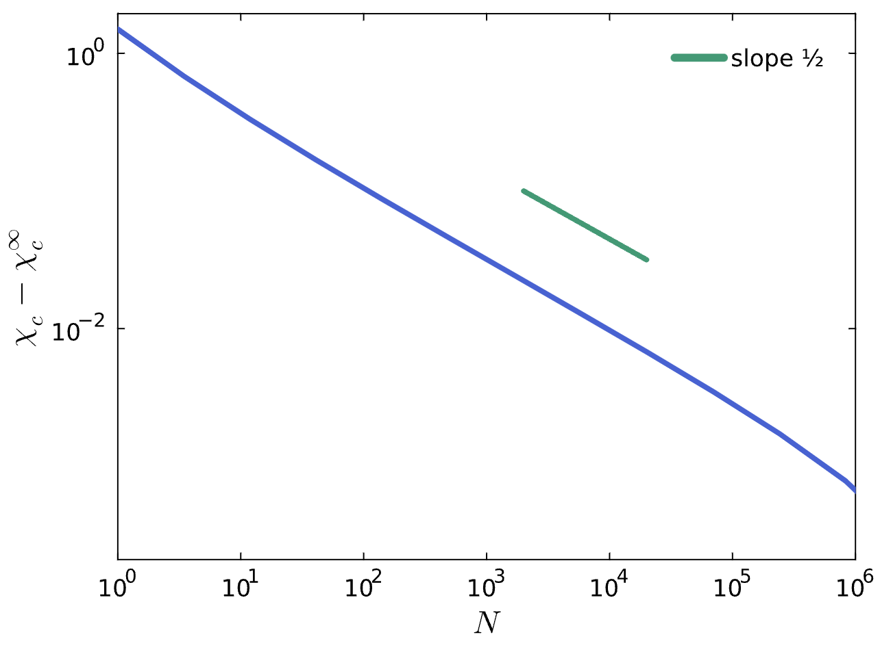
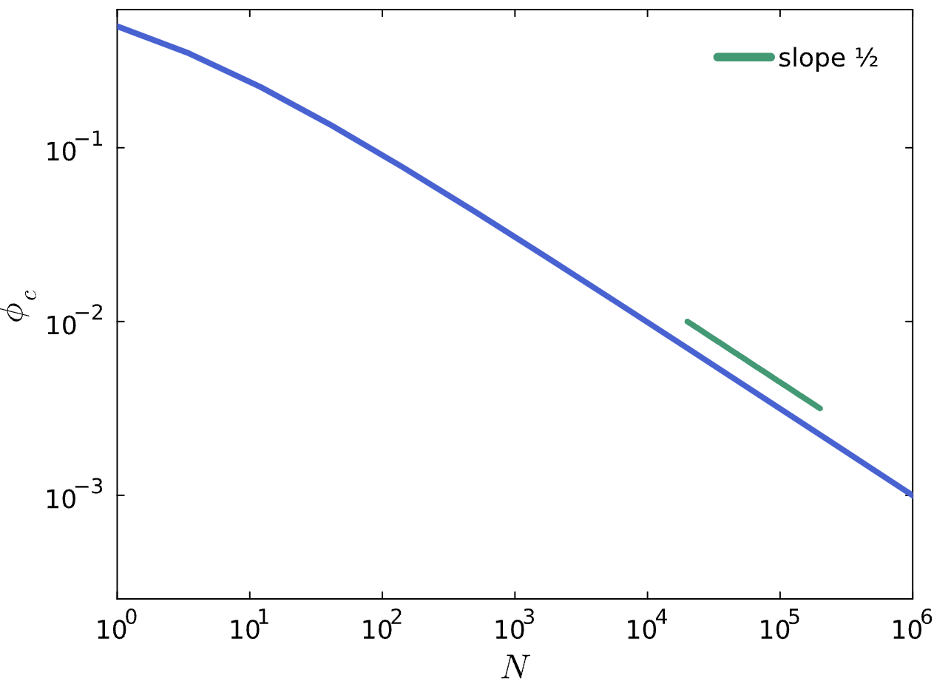
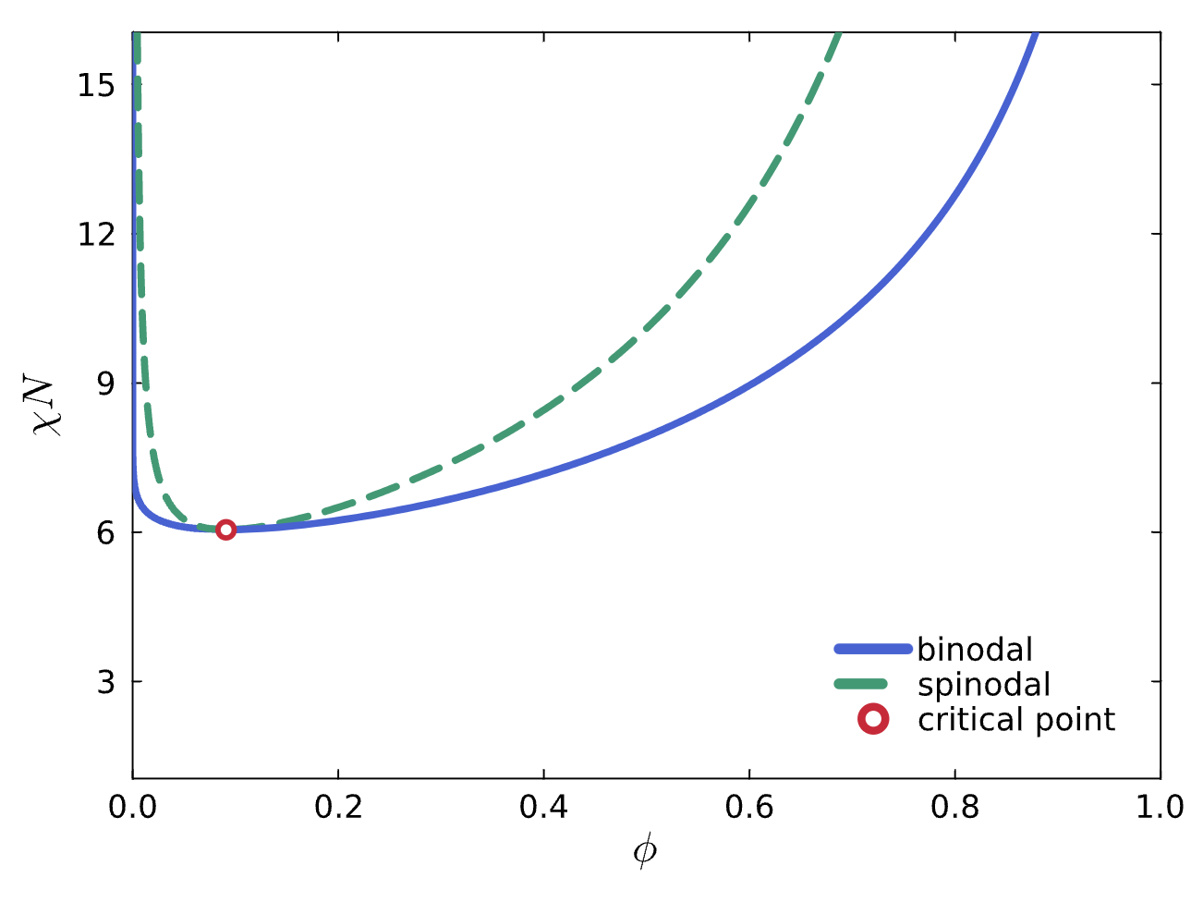
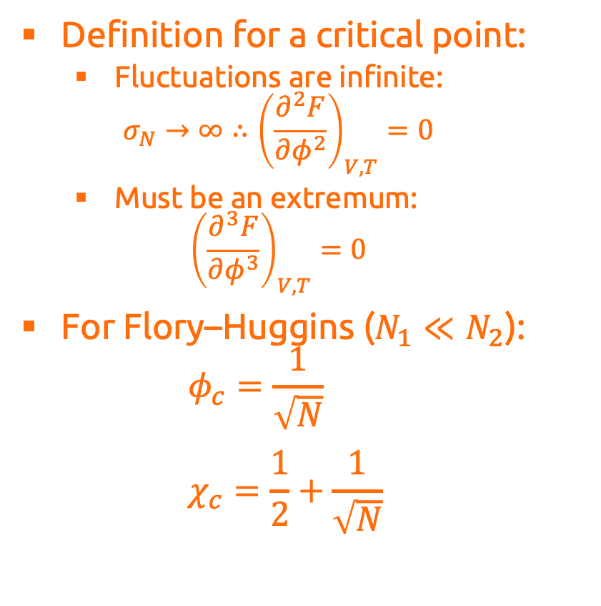
Criticality
Definition for a critical point:
Fluctuations are infinite: $σ_{N}→∞∴{\left(\frac{∂^{2}F}{∂φ^{2}}\right)}_{V,T}=0$
Must be an extremum: ${\left(\frac{∂^{3}F}{∂φ^{3}}\right)}_{V,T}=0$
For Flory–Huggins ($N_{1}≪N_{2}$): $φ_{c}=\frac{1}{\sqrt{N}}$ $χ_{c}=\frac{1}{2}+\frac{1}{\sqrt{N}}$

Slide 26
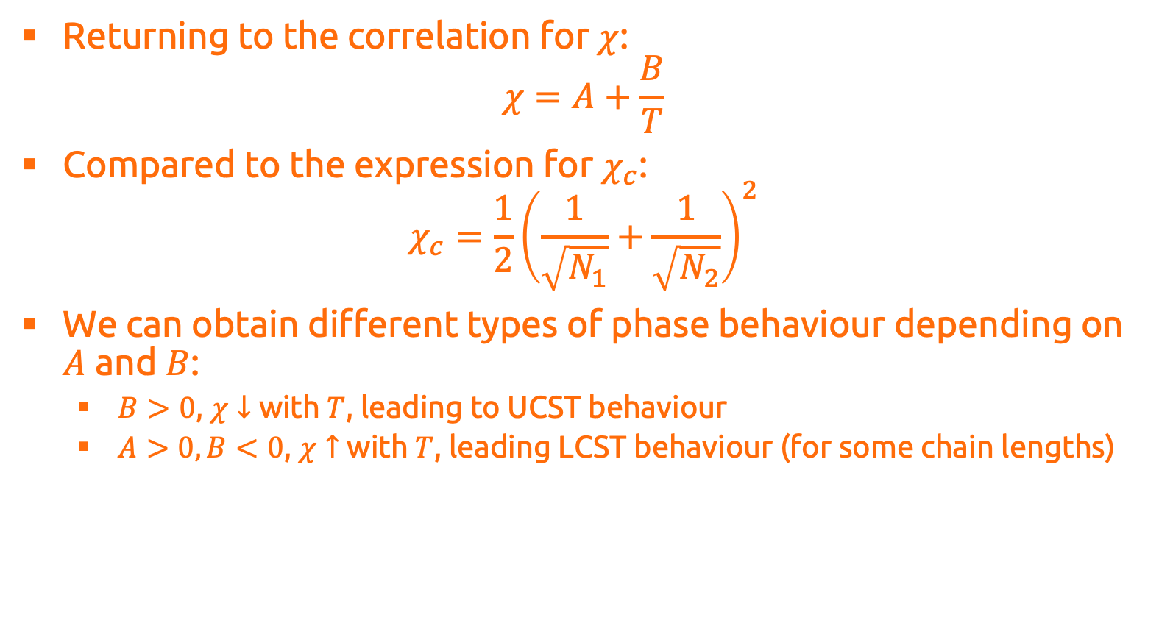
Application
Returning to the correlation for $χ$: $χ=A+\frac{B}{T}$
Compared to the expression for $χ_{c}$: $χ_{c}=\frac{1}{2}{\left(\frac{1}{\sqrt{N_{1}}}+\frac{1}{\sqrt{N_{2}}}\right)}^{2}$
We can obtain different types of phase behaviour depending on $A$ and $B$:
$B>0$, $χ↓$ with $T$, leading to UCST behaviour
$A>0, B<0$, $χ↑$ with $T$, leading LCST behaviour (for some chain lengths)

Slide 27
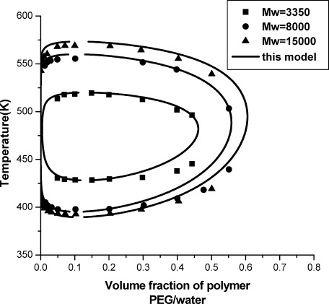
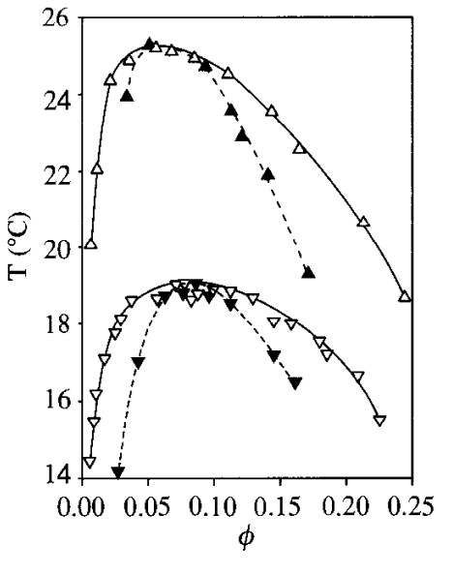
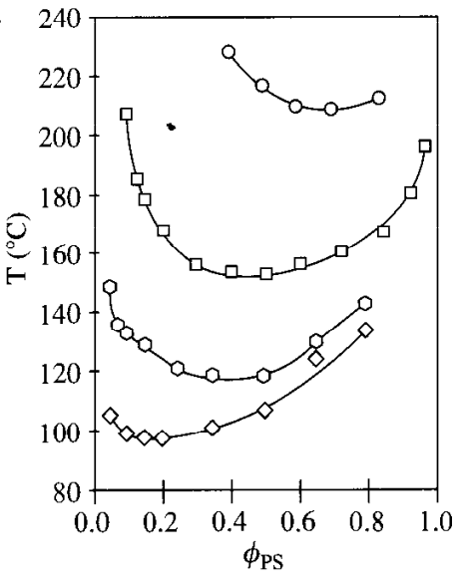
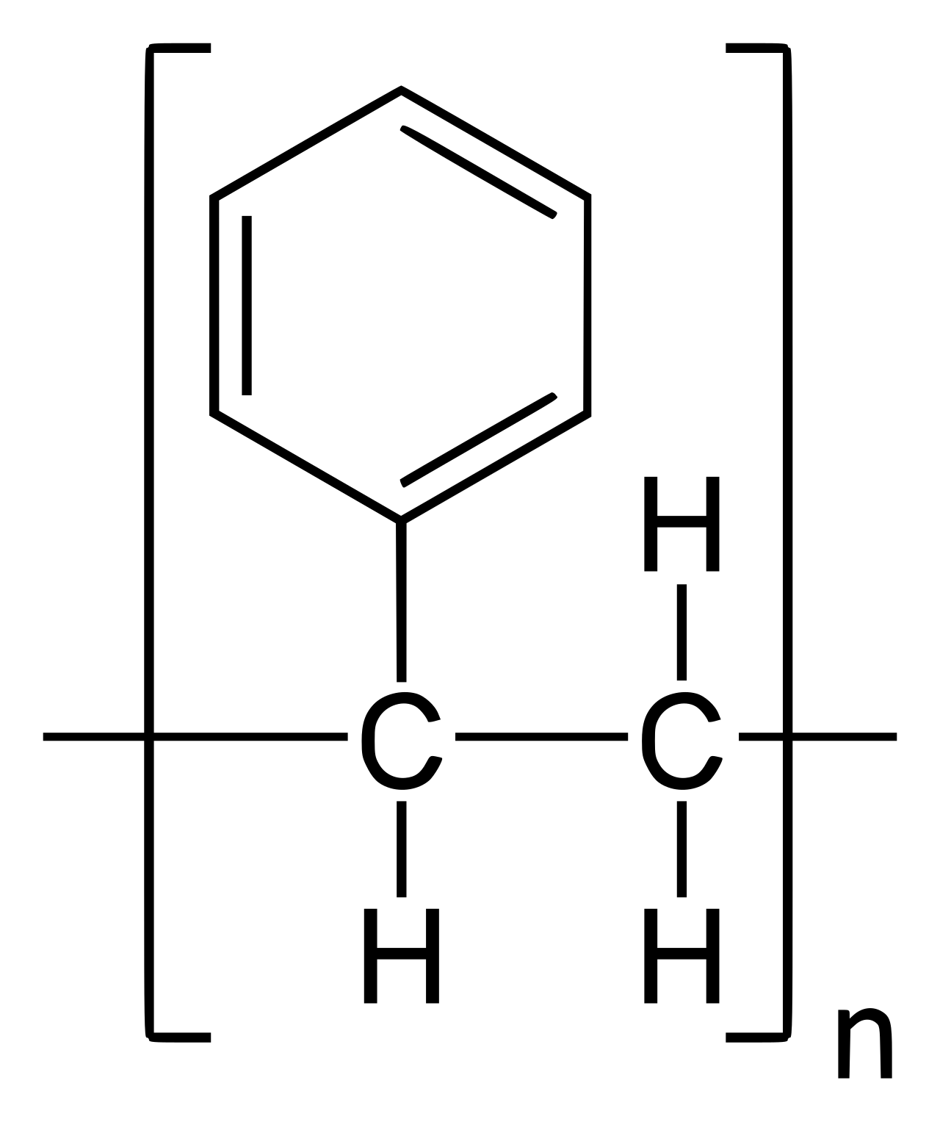
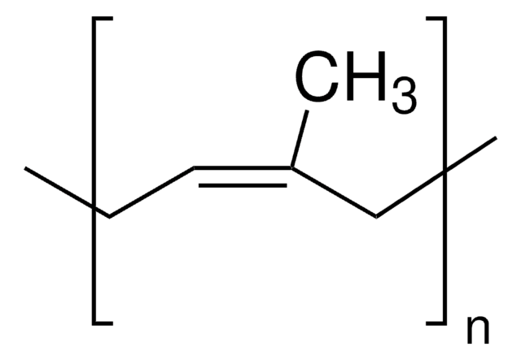
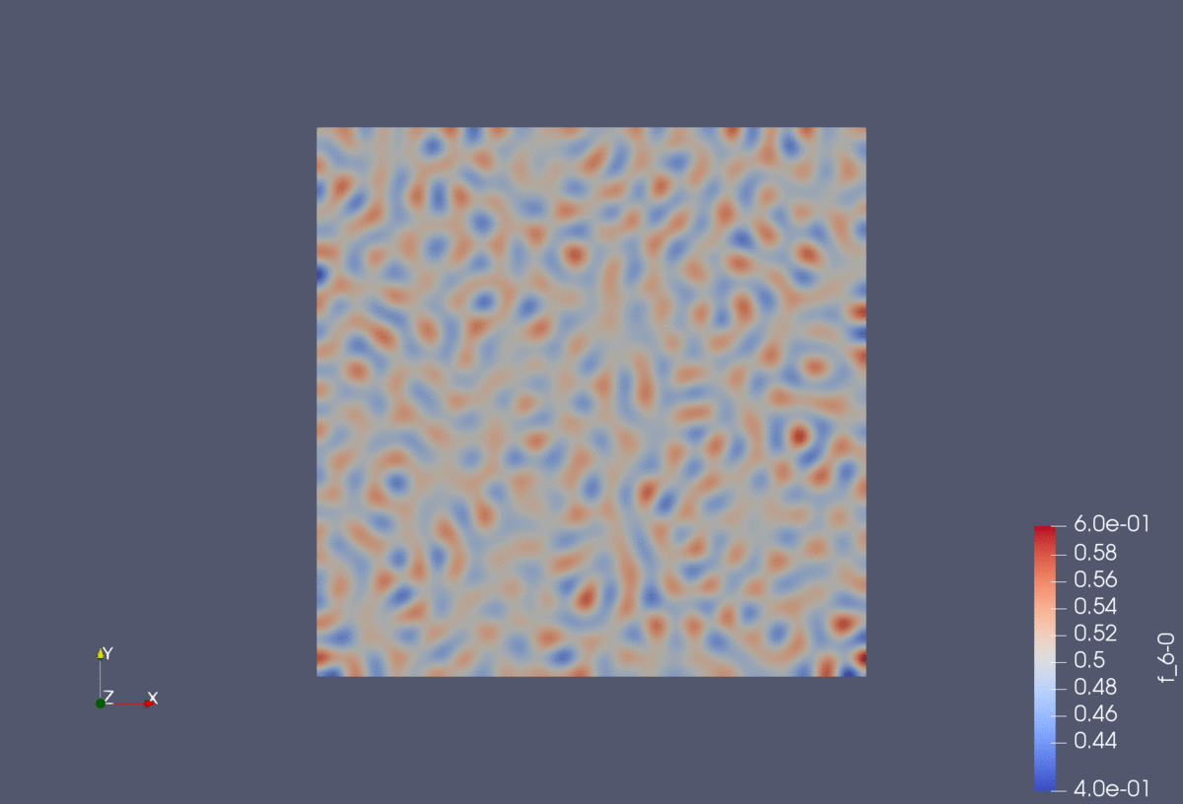
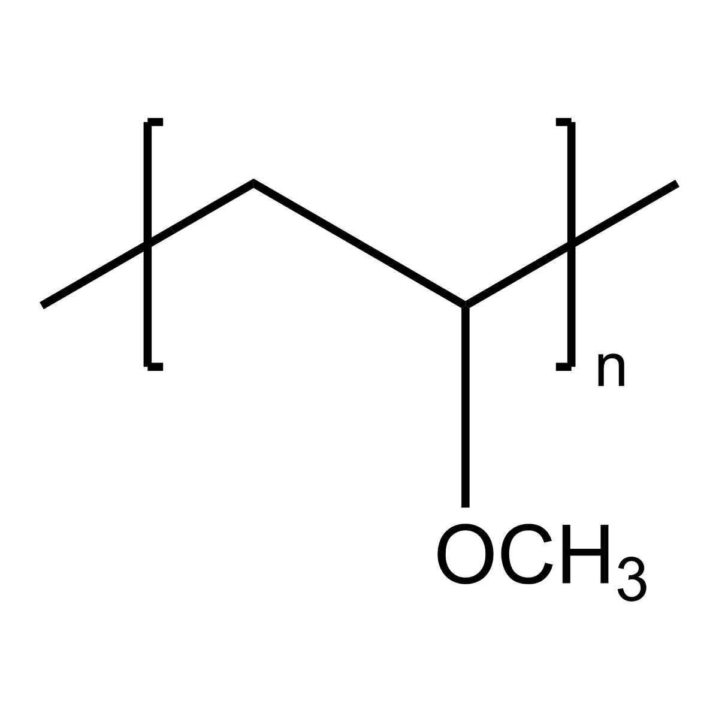
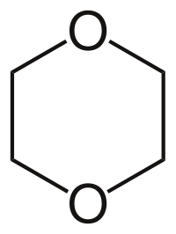
Application
Despite its approximations, the Flory–Huggins expression does a remarkable job reproducing experimental results:
Its simple form also allows for easy implementation in other theories like Cahn–Hilliard:

Slide 28
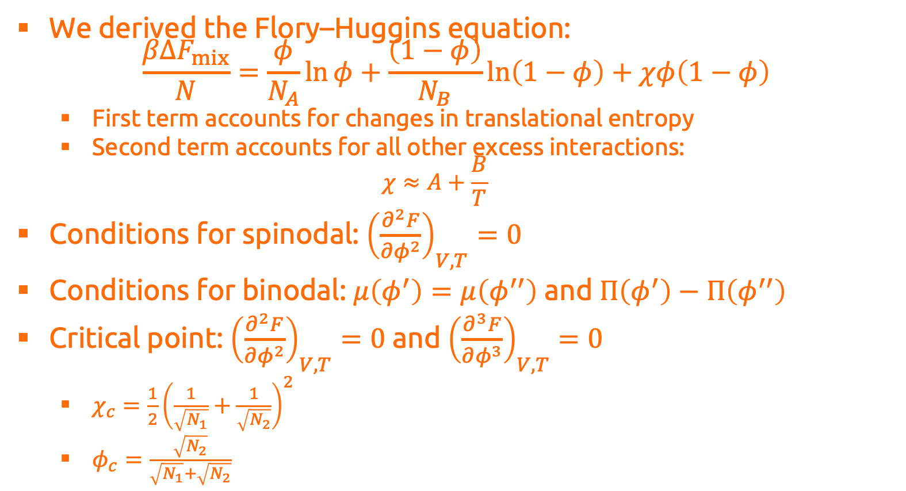
Summary
We derived the Flory–Huggins equation: $\frac{βΔF_{mix}}{N}=\frac{φ}{N_{A}}\ln{φ}+\frac{\left(1−φ\right)}{N_{B}}\ln\left(1−φ\right)+χφ\left(1−φ\right)$
First term accounts for changes in translational entropy
Second term accounts for all other excess interactions: $χ≈A+\frac{B}{T}$
Conditions for spinodal: ${\left(\frac{∂^{2}F}{∂φ^{2}}\right)}_{V,T}=0$
Conditions for binodal: $μ\left(φ^{′}\right)=μ\left(φ^{′′}\right)$ and $Π\left(φ^{′}\right)−Π\left(φ^{′′}\right)$
Critical point: ${\left(\frac{∂^{2}F}{∂φ^{2}}\right)}_{V,T}=0$ and ${\left(\frac{∂^{3}F}{∂φ^{3}}\right)}_{V,T}=0$
$χ_{c}=\frac{1}{2}{\left(\frac{1}{\sqrt{N_{1}}}+\frac{1}{\sqrt{N_{2}}}\right)}^{2}$
$φ_{c}=\frac{\sqrt{N_{2}}}{\sqrt{N_{1}}+\sqrt{N_{2}}}$

Slide 29
Polymer Solutions

Slide 30
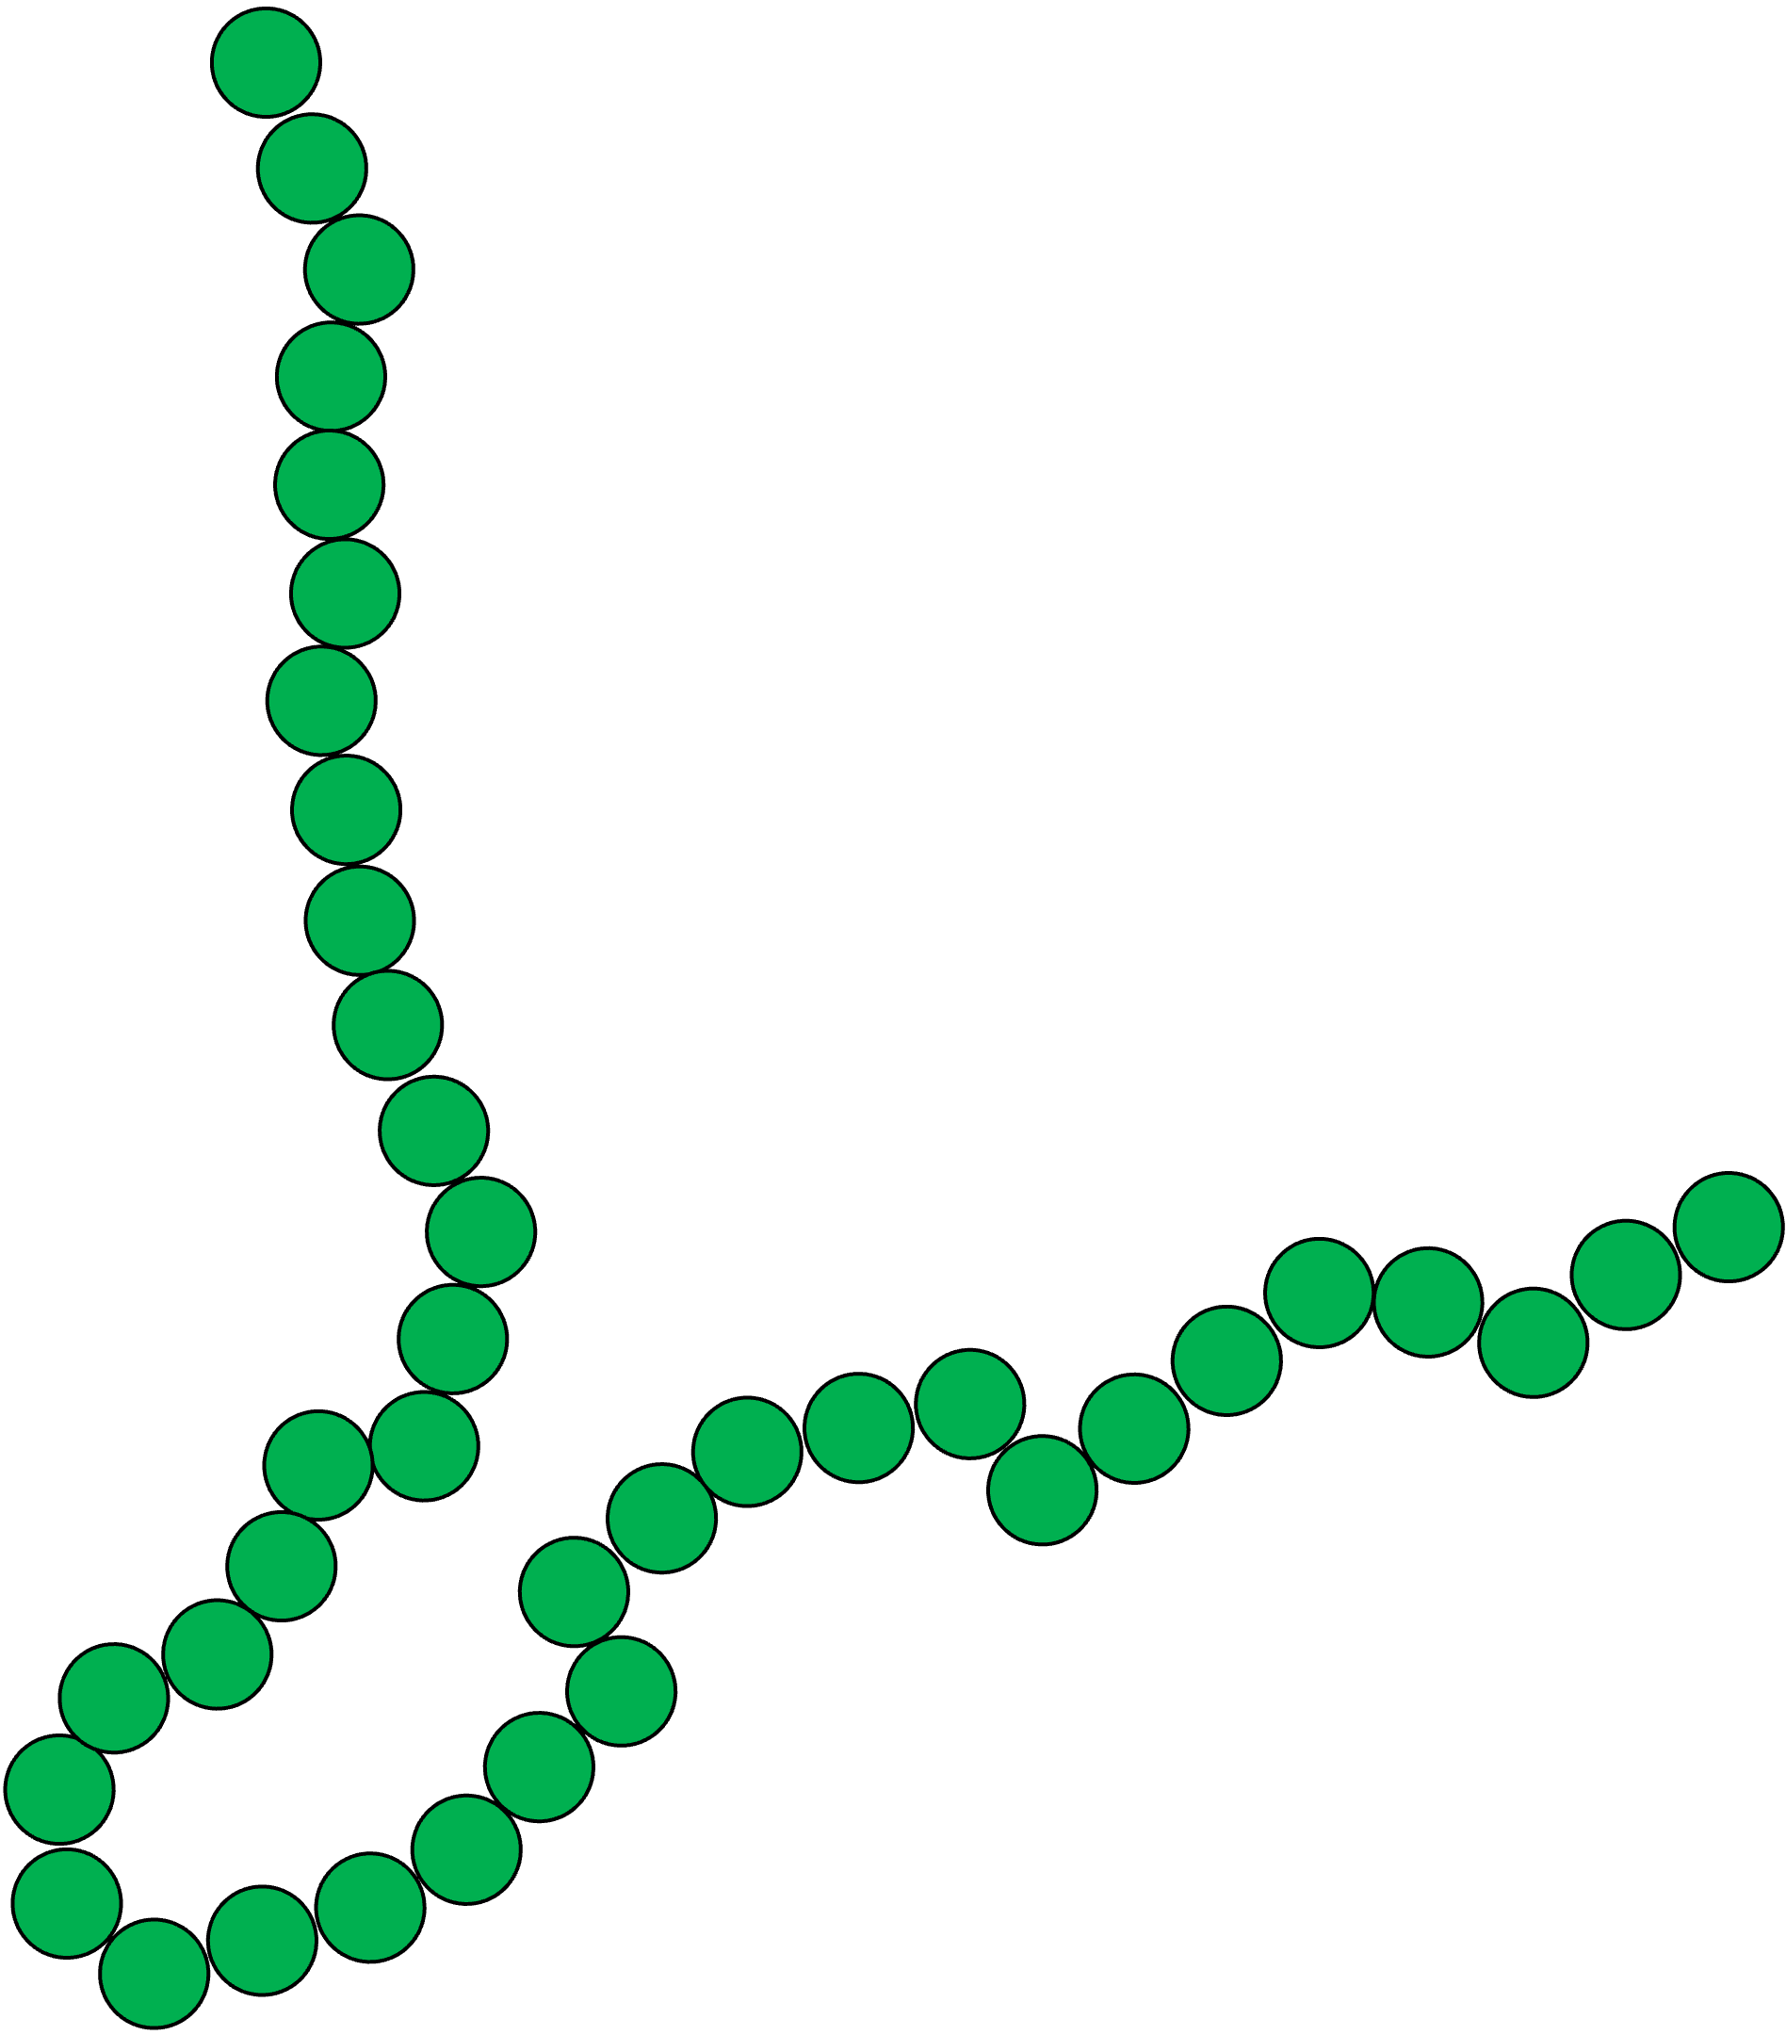
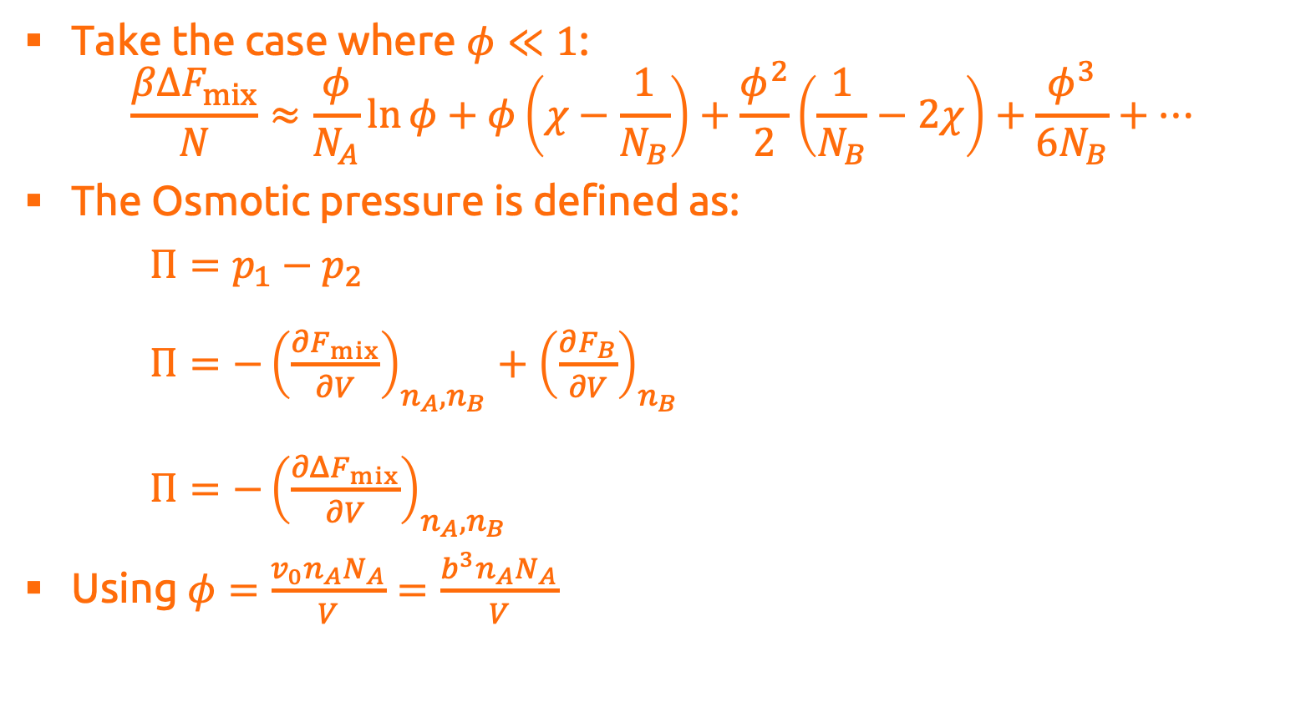
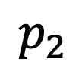
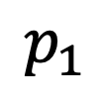
Dilute Mixtures
Take the case where $φ≪1$:
$$\frac{βΔF_{mix}}{N}≈\frac{φ}{N_{A}}\ln{φ}+φ\left(χ−\frac{1}{N_{B}}\right)+\frac{φ^{2}}{2}\left(\frac{1}{N_{B}}−2χ\right)+\frac{φ^{3}}{6N_{B}}+…$$
The Osmotic pressure is defined as:
$Π=p_{1}−p_{2}$ $Π=−{\left(\frac{∂F_{mix}}{∂V}\right)}_{n_{A},n_{B}}+{\left(\frac{∂F_{B}}{∂V}\right)}_{n_{B}}$ $Π=−{\left(\frac{∂ΔF_{mix}}{∂V}\right)}_{n_{A},n_{B}}$
Using $φ=\frac{v_{0}n_{A}N_{A}}{V}=\frac{b^{3}n_{A}N_{A}}{V}$
X
$$p_{1}$$
$$p_{2}$$

Slide 31

Dilute Mixtures
Take the case where $φ≪1$:
$$\frac{βΔF_{mix}}{N}≈\frac{φ}{N_{A}}\ln{φ}+φ\left(χ−\frac{1}{N_{B}}\right)+\frac{φ^{2}}{2}\left(\frac{1}{N_{B}}−2χ\right)+\frac{φ^{3}}{6N_{B}}+…$$
The Osmotic pressure is defined as:
$Π=p_{1}−p_{2}$ $Π=−{\left(\frac{∂F_{mix}}{∂V}\right)}_{n_{A},n_{B}}+{\left(\frac{∂F_{B}}{∂V}\right)}_{n_{B}}$ $Π=\frac{φ^{2}}{b^{3}}\left(\frac{∂\left({ΔF_{mix}}/φ\right)}{∂φ}\right)$
Using $φ=\frac{v_{0}n_{A}N_{A}}{V}=\frac{b^{3}n_{A}N_{A}}{V}$
X
$$p_{1}$$
$$p_{2}$$

Slide 32

Dilute Mixtures
Take the case where $φ≪1$:
$$\frac{βΔF_{mix}}{N}≈\frac{φ}{N_{A}}\ln{φ}+φ\left(χ−\frac{1}{N_{B}}\right)+\frac{φ^{2}}{2}\left(\frac{1}{N_{B}}−2χ\right)+\frac{φ^{3}}{6N_{B}}+…$$
The Osmotic pressure is defined as:
$Π=p_{1}−p_{2}$ $Π=−{\left(\frac{∂F_{mix}}{∂V}\right)}_{n_{A},n_{B}}+{\left(\frac{∂F_{B}}{∂V}\right)}_{n_{B}}$ $Π=\frac{kT}{b^{3}}\left(\frac{φ}{N_{A}}+\frac{φ^{2}}{2}\left(\frac{1}{N_{B}}−2χ\right)+\frac{φ^{3}}{3N_{B}}+…\right)$
Using $φ=\frac{v_{0}n_{A}N_{A}}{V}=\frac{b^{3}n_{A}N_{A}}{V}$
X
$$p_{1}$$
$$p_{2}$$

Slide 33

Dilute Mixtures
Take the case where $φ≪1$:
$$\frac{βΔF_{mix}}{N}≈\frac{φ}{N_{A}}\ln{φ}+φ\left(χ−\frac{1}{N_{B}}\right)+\frac{φ^{2}}{2}\left(\frac{1}{N_{B}}−2χ\right)+\frac{φ^{3}}{6N_{B}}+…$$
The Osmotic pressure is defined as:
$Π=p_{1}−p_{2}$ $Π=−{\left(\frac{∂F_{mix}}{∂V}\right)}_{n_{A},n_{B}}+{\left(\frac{∂F_{B}}{∂V}\right)}_{n_{B}}$ $Π=kT\left(\frac{c_{n}}{N_{A}}+\frac{c_{n}^{2}}{2}\left(\frac{1}{N_{B}}−2χ\right)b^{3}+\frac{b^{6}c_{n}^{3}}{3N_{B}}+…\right)$
Using $φ=\frac{v_{0}n_{A}N_{A}}{V}=\frac{b^{3}n_{A}N_{A}}{V}$
X
$$p_{1}$$
$$p_{2}$$

Slide 34

Dilute Mixtures
Take the case where $φ≪1$:
$$\frac{βΔF_{mix}}{N}≈\frac{φ}{N_{A}}\ln{φ}+φ\left(χ−\frac{1}{N_{B}}\right)+\frac{φ^{2}}{2}\left(\frac{1}{N_{B}}−2χ\right)+\frac{φ^{3}}{6N_{B}}+…$$
The Osmotic pressure is defined as:
$Π=p_{1}−p_{2}$ $Π=−{\left(\frac{∂F_{mix}}{∂V}\right)}_{n_{A},n_{B}}+{\left(\frac{∂F_{B}}{∂V}\right)}_{n_{B}}$ $Π=kT\left(\frac{c_{n}}{N_{A}}+\frac{v}{2}c_{n}^{2}+wc_{n}^{3}+…\right)$
Giving:
The excluded volume: $v=\left(\frac{1}{N_{B}}−2χ\right)b^{3}$
Three-body interaction: $w=\frac{b^{6}}{3N_{B}}$
X
$$p_{1}$$
$$p_{2}$$

Slide 35

Dilute Mixtures
For a polymer solution ($N_{B}=1$, $N_{A}=N$): $Π=kT\left(\frac{c_{n}}{N}+\frac{1}{2}\left(1−2χ\right)b^{3}c_{n}^{2}+\frac{b^{6}}{3}c_{n}^{3}+…\right)$
Interpretation:
For very low compositions (van’t Hoff’s law): $Π=kT\frac{c_{n}}{N}$ Each chain $A$ will contribute $kT$ to $Π$
When $\left(1−2χ\right)=0→χ=\frac{1}{2}$, energetic and entropic contributions perfectly cancel, leading to ideal chain behaviour
For $χ<\frac{1}{2}$, $Π$ increases due to favourable interactions between solvent and chain (good solvent).
Gives an experimental method to determine $χ$!
X
$$p_{1}$$
$$p_{2}$$

Slide 36

Semi-Dilute Solutions
For a polymer solution ($N_{B}=1$, $N_{A}=N$): $Π=kT\left(\frac{c_{n}}{N}+\frac{1}{2}\left(1−2χ\right)b^{3}c_{n}^{2}+\frac{b^{6}}{3}c_{n}^{3}+…\right)$
In a good solvent, with increasing concentration, the second term will dominate: $Π≈kTvc_{n}^{2}$
Osmotic pressure is independent of molar mass ✔️
This mean-field theory predicts that the semi-dilute regime is reached when: $\frac{c_{n}}{N}≈vc_{n}^{2}→φ_{sd}≈\frac{b^{3}}{vN}$ which is a very low concentration…
It also gets the scaling of $Π$ with $φ$ wrong…

Slide 37


Semi-Dilute Solutions
For a polymer solution ($N_{B}=1$, $N_{A}=N$): $Π=kT\left(\frac{c_{n}}{N}+\frac{1}{2}\left(1−2χ\right)b^{3}c_{n}^{2}+\frac{b^{6}}{3}c_{n}^{3}+…\right)$
The primary mistake that Flory–Huggins makes is assuming a uniform distribution of monomers in solution
Ignores correlations between monomers
At what concentration does the excluded volume matter?
We know for a single chain with excluded volume in a good solvent: $R≈b{\left(\frac{v}{b}\right)}^{2ν−1}N^{ν};\left(ν≈0.588\right)$
Chains will begin to overlap when: $φ^{∗}=\frac{nNb^{3}}{nR^{3}}≈{\left(\frac{b^{3}}{v}\right)}^{6ν−3}N^{1−3ν}$
$$R$$

Slide 38



Semi-Dilute Solutions
For a polymer solution ($N_{B}=1$, $N_{A}=N$): $Π=kT\left(\frac{c_{n}}{N}+\frac{1}{2}\left(1−2χ\right)b^{3}c_{n}^{2}+\frac{b^{6}}{3}c_{n}^{3}+…\right)$
We define the semidilute regime when $φ^{∗}<φ≪1$
In this regime, there will a number of monomers which act as if they are a single chain ($g$):
The correlation length $ξ$ is then defined as: $ξ≈b{\left(\frac{v}{b}\right)}^{2ν−1}g^{ν}$
The concentration of monomers in this volume will match the actual concentration of the solution: $φ=\frac{gb^{3}}{ξ^{3}}→ξ≈b{\left(\frac{b^{3}}{v}\right)}^{{\left(2ν−1\right)}/{\left(3ν−1\right)}}φ^{−ν/{\left(3ν−1\right)}}$
$$ξ$$
$$g$$

Slide 39




Semi-Dilute Solutions
The chain formed from blobs of size $ξ$ behave as if they are in a melt
The size of the chain can then be written as: $R≈ξ{\left(\frac{N}{g}\right)}^{\frac{1}{2}}≈b{\left(\frac{v}{b^{3}φ}\right)}^{{\left(ν−1/2\right)}/{\left(3ν−1\right)}}N^{\frac{1}{2}}$
Return to the ½ scaling!
With increasing $N$, we will see changes in slope for the polymer size
Note that $ξ$ decreases with $φ$, but $ξ_{T}\left(=\frac{b^{4}}{v}\right)$doesn’t.
When $ξ<ξ_{T}$, we will have reached the concentrated regime:
$$b{\left(\frac{b^{3}}{v}\right)}^{{\left(2ν−1\right)}/{\left(3ν−1\right)}}{\left(φ^{∗∗}\right)}^{−ν/{\left(3ν−1\right)}}=\frac{b^{4}}{v}→φ^{∗∗}≈\frac{v}{b^{3}}$$
Semi-dilute regime:
$${\left(\frac{b^{3}}{v}\right)}^{6ν−3}N^{1−3ν}<φ<\frac{v}{b^{3}}$$
$$ξ$$
$$g$$

Slide 40



Semi-Dilute Solutions
We still want an expression for $Π$ in the semi-dilute regime.
Using de Gennes scaling theory:
$$Π≈\frac{kT}{b^{3}}\frac{φ}{N}f\left(\frac{φ}{φ^{∗}}\right)$$
At $φ=φ^{∗}$, we want the limiting behaviour to follow van’t Hoff’s law: $f\left(1\right)≈1$
Use a power law form: $Π≈\frac{kT}{b^{3}}\frac{φ}{N}{\left(\frac{φ}{φ^{∗}}\right)}^{z}$
Substitute $φ^{∗}$: $Π≈\frac{kT}{b^{3}}φ^{1+z}{\left(\frac{v}{b^{3}}\right)}^{3z\left(2ν−1\right)}N^{\left(3ν−1\right)z−1}$
We know $Π∝N^{0}$: $\left(3ν−1\right)z−1=0→z={\left(3ν−1\right)}^{−1}$
Giving: $Π≈\frac{kT}{b^{3}}{\left(\frac{v}{b^{3}}\right)}^{0.69}φ^{2.3}$
$$\frac{Πb^{3}N}{φkT}≈1+{\left(\frac{φ}{φ^{∗}}\right)}^{1.3}$$

Slide 41

Summary
Osmotic pressure is the $Δp$ when a membrane separates a solute from the pure solvent
From Flory–Huggins: $Π=kT\left(\frac{c_{n}}{N}+\frac{c_{n}^{2}}{2}\left(1−2χ\right)b^{3}+\frac{b^{6}c_{n}^{3}}{3}+…\right)$
The excluded volume: $v=\left(1−2χ\right)b^{3}$
Three-body interaction: $w=\frac{b^{6}}{3}$
Theta-point is when $χ=\frac{1}{2}$
In the dilute limit ($φ<φ^{∗}$): $Π≈\frac{kTc_{n}}{N}$
In the semi-dilute limit ($φ^{∗}<φ<φ^{∗∗}$):
Flory–Huggins misses-out on monomer-monomer correlations
Osmotic pressure: $Π∝φ^{2.3}$

Slide 42
Beyond Flory–Huggins

Slide 43



Alternative Theories
The $χ$ parameter abstracts away a lot of the physics:
What leads to LCST / looping behaviour?
UNIFAC-FV provides an improvement to FH: $βΔF_{ex.}=βΔF_{comb.}+βΔF_{res.}$
Fitting to smaller molecules allows UNIFAC to extrapolate to longer chains
Still more of a correlation…
SAFT-type equations provide a separation of contributions: $βF_{res}=βF_{hs}+βF_{chain}+βF_{disp.}+βF_{assoc.}$
Can better understand the physics of what leads to LCST / looping behaviour
assoc., disp. < id.
assoc. < disp.
assoc. > disp.

Slide 44



Polyelectrolytes
One interaction that cannot be capture by $χ$ is electrostatics…
Voorn and Overbeek (1957) included the simplified equation of Debye–Hückel to account for the electrostatics: $\frac{βF}{N}=\sum_{i}{\frac{φ_{i}}{N_{i}}\ln{φ_{i}}}−\frac{κ^{3}}{12π}$
Can predict polyelectrolyte coacervation
Incorrectly predicts positive tie-lines
Cannot predict re-entrant behaviour
Limiting assumptions:
Low ionic strength
Ignores configurational entropy when forming chains of charged monomers

Slide 45



Polyelectrolytes
Based on the MSA theory by Blum (1977), Zhang and Wang (2017) developed liquid state theory:
$$βF=βF_{id.}+βF_{hs}+βF_{el.}+βF_{ch}$$
Starts from a hard-sphere reference (excluded volume)
Include electrostatics with a more-accurate theory
Account for the entropy change from forming chains
Substantial improvements on Voorn–Overbeek:
Correct tie lines
Re-entrant behaviour
Reproduce experimental results
-
+
+
+
-
+
+
-
+
+
-
+
-
-
-
-
-
-
+
+

Slide 46




PEO+IL System
PEO+IL is an interesting system:
Hydrophilic chain
Hydrophobic (ish) ‘solvent’
Would expect UCST behaviour, skewed towards pure solvent
Reality: centered LCST(?)
Explaining the LCST:
PEO and EMIM will experience some hydrogen bonding:

Slide 47

PEO+IL System
Explaining the location of the LCST is harder:
Flory–Huggins and most other theories would agree the LCST should be skewed
Most previous theories argue that the change is due to aggregation of ILs into larger molecules:

Slide 48

PEO+IL System
The clustering argument has some flaws:
Large clusters only form when there is a high enough IL concentration
The addition of PEO will disrupt the cluster formation
What if it’s just the electrostatics?
Taking a very simplified model
For a symmetric system ($N_{p}=1$), starts off on the polymer side!
Increasing the chain length does push the critical point back to the IL side
In the PEO+IL system, $N≈10$

Slide 49



PEO+IL System
The critical scaling also changes
In Flory–Huggins: $χ_{c}=\frac{1}{2}+\frac{1}{\sqrt{N}}$ $φ_{c}=\frac{1}{\sqrt{N}}$
In this system, both have a scaling of $\frac{1}{N}$

Slide 50

Future Work
‘Complete’ model for PEO+IL
Include PEO-IL association for the LCST behaviour
Must include electrostatics to account for the shift in LLE
Further study of the critical behaviour:
What happens when you include $χ$ in the theory?
For sufficiently large $χ$, will we recover the original scaling?

